Slide 1
TWO
HIGH QUALITY AT AN AFFORDABLE PRICE
03/2026

Slide 2
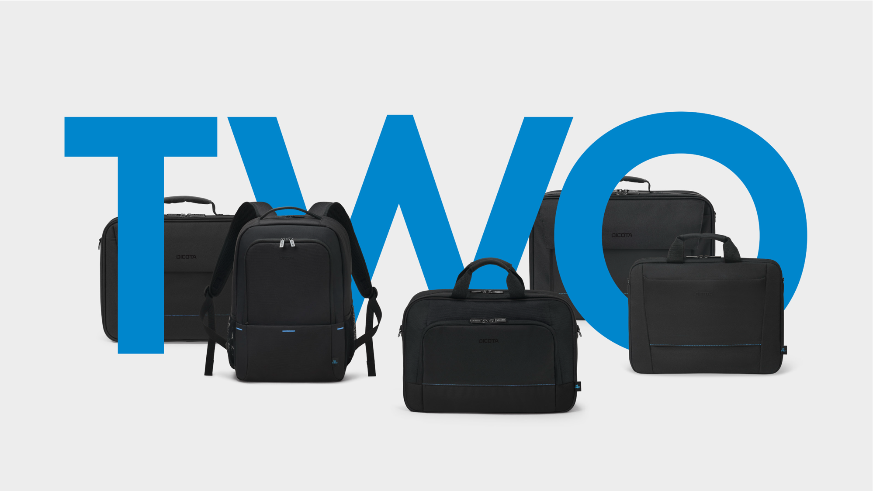
TWO KEY VISUAL
We created for the new TWO family a special KEY VISUAL which will be used for all communication
and promotions around the TWO to give a consistent and emotional welcome to the new family.

Slide 3
TWO – THE STORY CONTINUES
TWO is the newest member of the Business Entry range, designed for our customers
with high tender and/or project volumes who are looking for high quality at an affordable price (good value for money). It is just as versatile and reliable as its predecessor, but even better.
The new family makes the good things of BASE even better – It shows that cost-effectiveness and quality go hand in hand
Therefore, TWO focuses on the most successful BASE construction types
It combines robust construction, functionality and durable materials
Only slight design adjustments such as a new blue highlight stitching line
Trolley straps now for all construction types
Well-structured compartments for quick access to power adapters, cables, documents, etc.

Slide 4
TWO – HIGHLIGHTS
Our bestseller getting even better:
Durable, recycled materials
Multiple compartments with a lot of storage space for documents, mobile accessories and personal belongings
Protects the notebook from pressure marks and display damage
Water-repellent outer material
Black inner lining gives it a serious look
Slightly cushioned handles, shoulder straps and a trolley attachment are standard features
Made with up to 12 recycled PET bottles

Slide 5
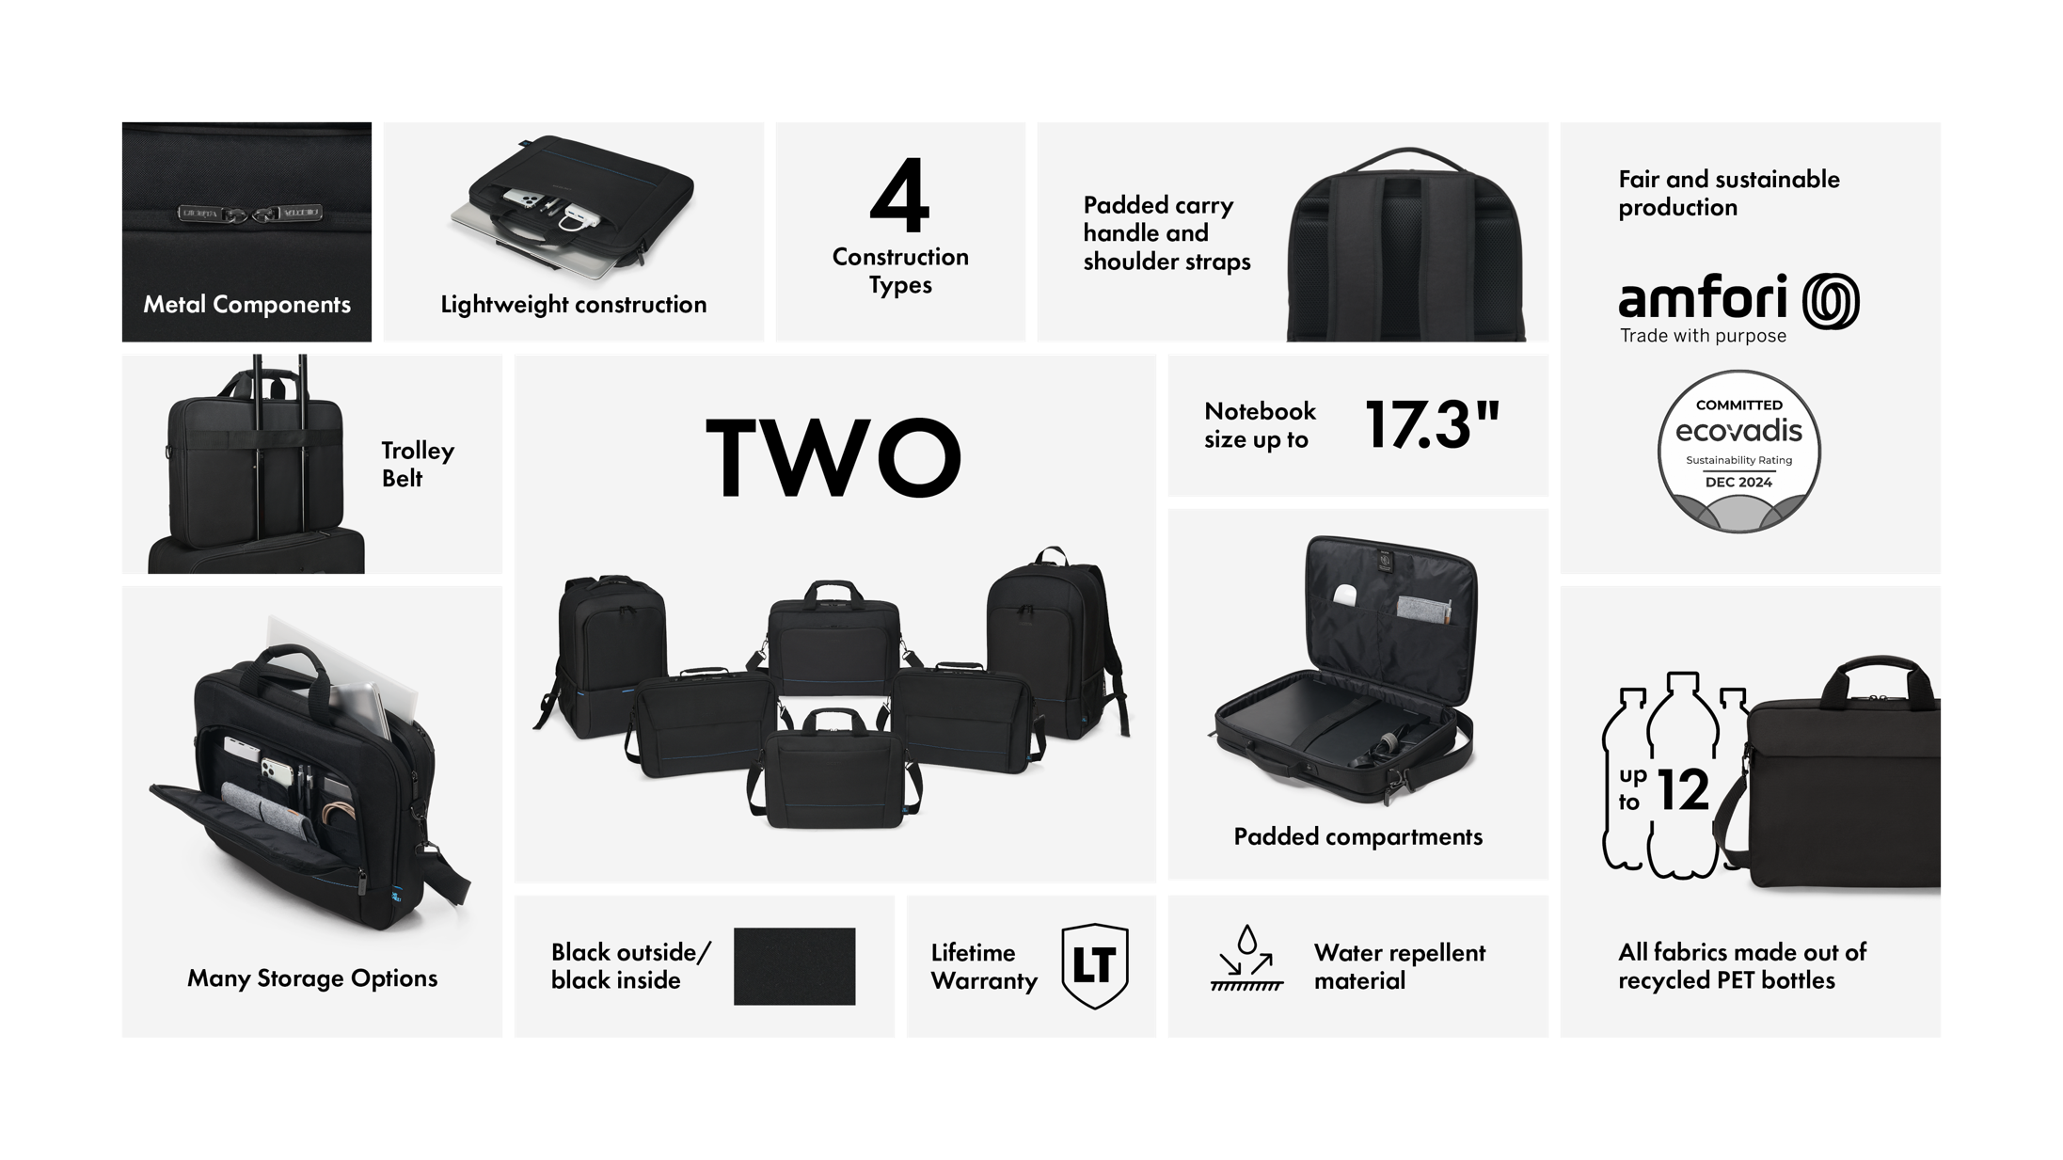

Slide 6
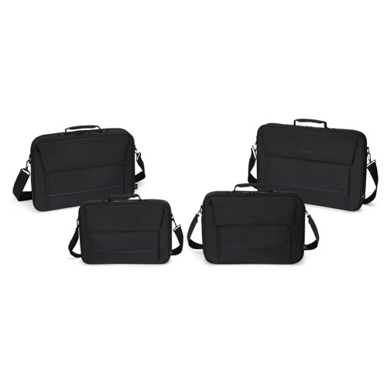
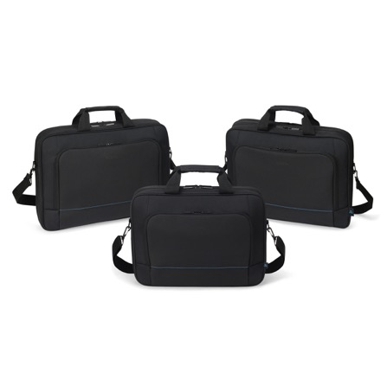
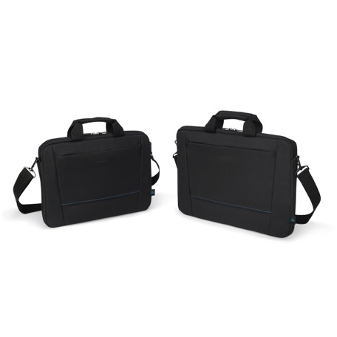
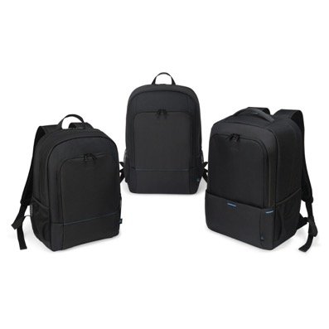
TWO – PORTFOLIO
  Four construction types to fit individual needs
  Fits notebooks up to 17.3”
  Fair and sustainably produced
Backpack TWO
13-14 D3250103
15-17.3 D3250104
Backpack PLUS TWO
14-16 D3250105
Multi TWO
13-14 D3250201
14-16 D3250202
15-17.3 D3250203
MULTI PLUS TWO
14-16 D3250204
Top traveller TWO
13-14 D3250803
14-16 D3250804
15-17.3 D3250805
SLIM CASE TWO
13-14 D3250602
14-16 D3250603

Slide 7
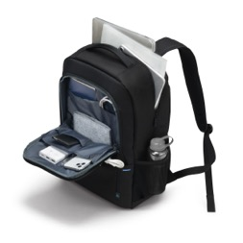
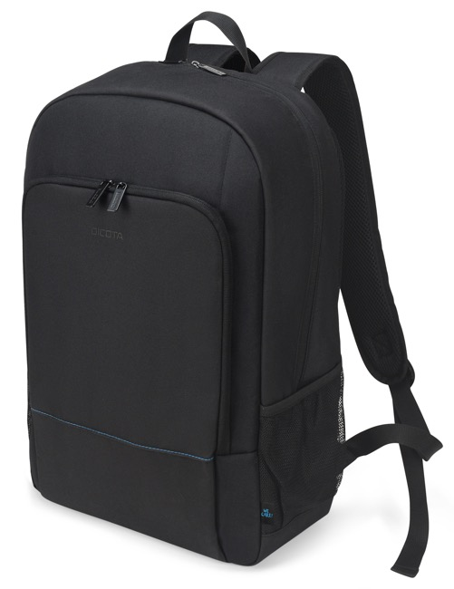
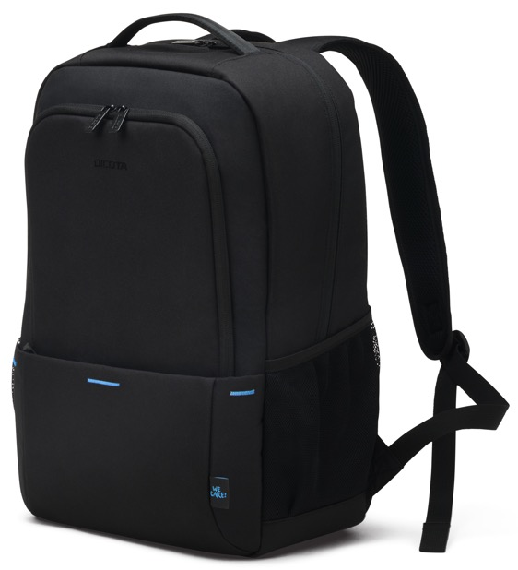
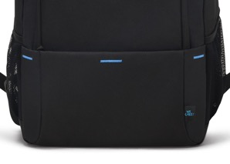
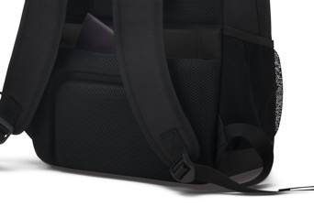
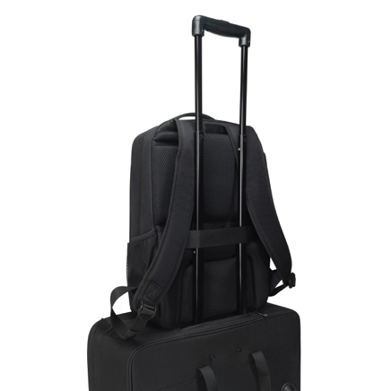
TWO – BACKPACKS
20 / 28 liter storage space (resp. 24 litre for Backpack PLUS)
Padded notebook compartment with high density foam (HDF)
High-quality metal features
Spacious main section with compartments for documents
Front pocket with storage space for mobile accessories
Ergonomic padded back
Easily accessible mesh side pockets for water bottle or umbrella
Removable, adjustable shoulder strap
Water-repellent material for comfortable travel in all weathers
Fair and sustainably made of 9/11 recycled PET bottles

Slide 8
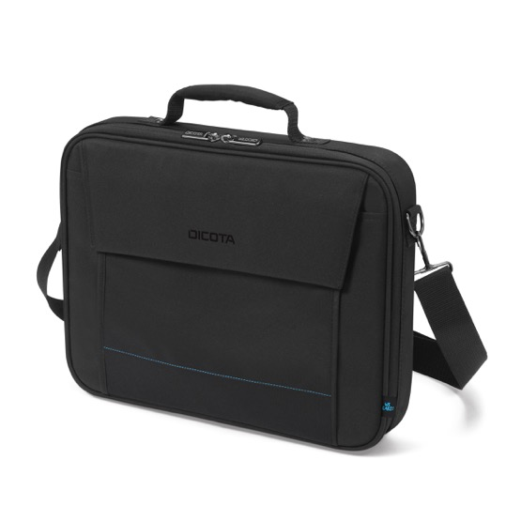
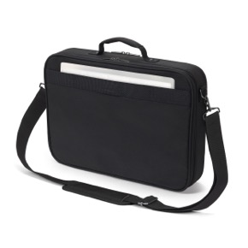
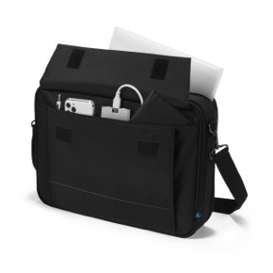
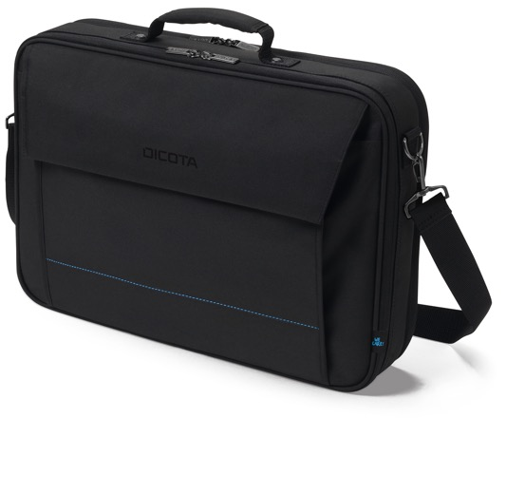
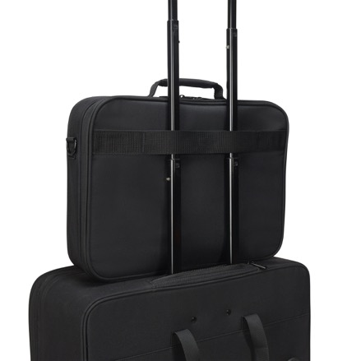
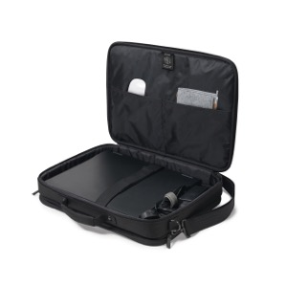
TWO – MULTI
Padded notebook compartment
Metal frame for extra protection
High-quality metal features
Notebook security strap
Document compartment on the back
Front pocket with storage space for mobile accessories
Comfortable padded handle
Removable, adjustable shoulder strap
Water-repellent material for comfortable travel in all weathers
Made of 9/11/11/12 recycled PET bottles

Slide 9
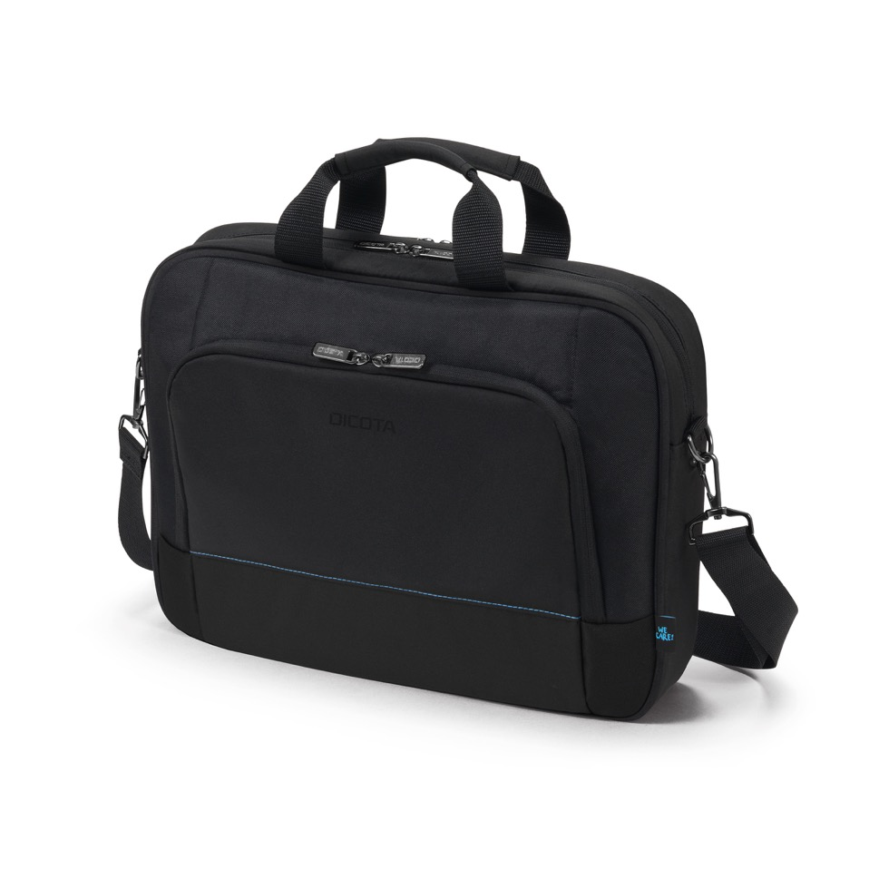
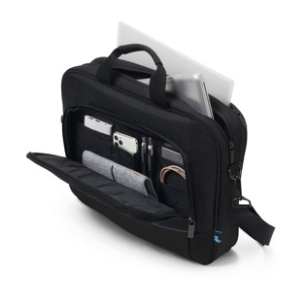
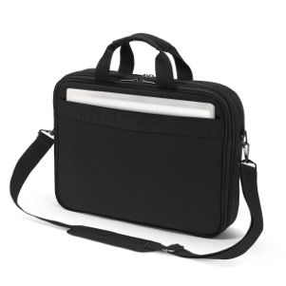
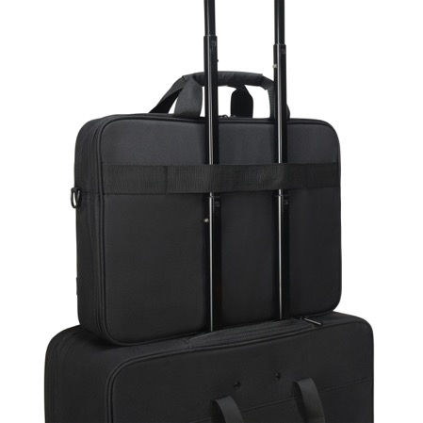
TWO – TOP TRAVELLER
Padded notebook compartment with high density foam (HDF)
Additional protection due to metal wire frame
High-quality metal features
Storage space for documents
Front pocket with storage space for mobile accessories
Suitcase fixation strap
Removable, adjustable shoulder strap
Water-repellent material for comfortable travel in all weathers
Made of 8/9/11 recycled PET bottles

Slide 10
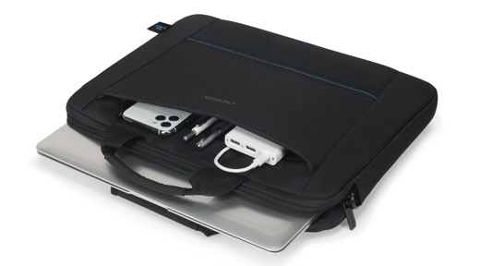
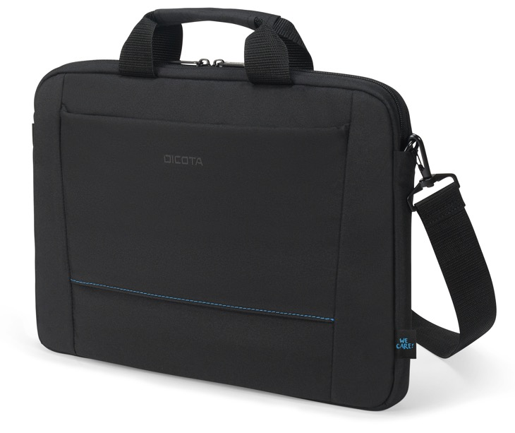
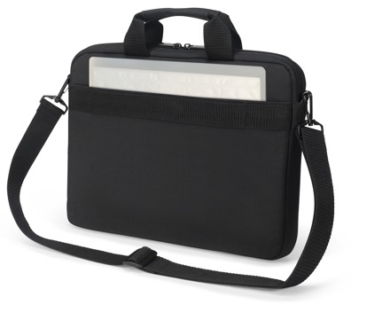
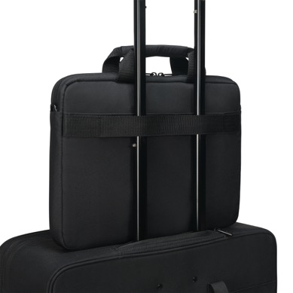
TWO – SLIM CASE
Padded notebook compartment with high density foam (HDF)
Additional protection due to metal wire frame
High-quality metal features
Storage space for documents
Front pocket with storage space for mobile accessories
Suitcase fixation strap
Removable, adjustable shoulder strap
Water-repellent material for comfortable travel in all weathers
Made of 4/5 recycled PET bottles

Slide 11
TWO – TARGET GROUP & SALES ARGUMENTS
Target User Group: Corporate (volume) tenders, basic corporate basket, and customers seeking for „value for money“
Target Customers: Companies with mobile IT infrastructure (IT, Banks, Administration, Sales, …)
Educational institutions and universities (for their teachers, lecturers, students,..)
Authorities & public institutions (with interest in sustainable products and security features)
→ Simple the perfect choice for everybody seeking a great product for an attractive price.
Customer Demands Benefits
Protection on the move → Robust construction, HDF cushioning and metal fittings for safe transportation of devices
Achieving sustainability goals → TWO uses up to 12 recycled PET bottles
Investment security → DICOTA stands for tested quality and durable materials - ideal for company equipment
Convenience for users → Cushioned handles, straps and trolley fastening - TWO offers convenience in everyday working life
Ease-of-use → Simple but functional design with enough storage space for additional accessories

Slide 12
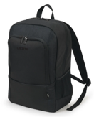
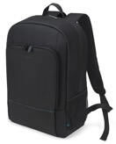
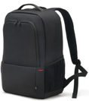
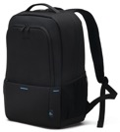
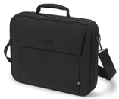
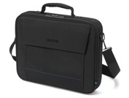
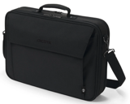
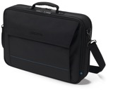
TWO – SUCCESSOR OVERVIEW
 | Item Code | Item Name |  | Item Code | Item Name
 | D30914-RPET | Eco Backpack BASE 13-14.1 | → | D3250103 | Backpack TWO 13-14
 | D30913-RPET | Eco Backpack BASE 15-17.3 | → | D3250104 | Backpack TWO 15-17.3
 | D31839-RPET | Eco Backpack Plus BASE 13-16 | → | D3250105 | Backpack Plus TWO 14-16
 | D31323-RPET | Eco Multi BASE 13-14.1 | → | D3250201 | Multi TWO 13-14
 | D30446-RPET | Eco Multi BASE 14-15.6 | → | D3250202 | Multi TWO 14-16
 | D30447-RPET | Eco Multi BASE 15-17.3 | → | D3250203 | Multi TWO 15-17.3
 | D30491-RPET | Eco Multi Plus BASE 14-15.6 | → | D3250204 | Multi Plus TWO 14-16

Slide 13
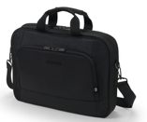
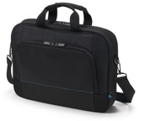
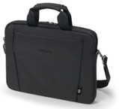
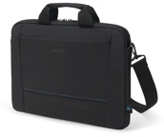
TWO – SUCCESSOR OVERVIEW
 | Item Code | Item Name |  | Item Code | Item Name
 | D31324-RPET | Eco Top Traveller BASE 13-14.1 | → | D3250803 | Top Traveller TWO 13-14
 | D31325-RPET | Eco Top Traveller BASE 15-16 | → | D3250804 | Top Traveller TWO 14-16
 | D31671-RPET | Eco Top Traveller BASE 15-17.3 | → | D3250805 | Top Traveller TWO 15-17.3
 | D31304-RPET | Eco Slim Case BASE 13-14.1 | → | D3250602 | Slim Case TWO 13-14
 | D31308-RPET | Eco Slim Case BASE 15-15.6 | → | D3250603 | Slim Case TWO 14-16

Slide 14
You never
work alone.
DICOTA SCHWEIZ AG
Churerstrasse 20, CH-8808 Pfäffikon SZ, Switzerland
www.dicota.com

