Slide 1
SEVEN
BEST IN CLASS. BUILT FOR THE FUTURE.
03/2026

Slide 2
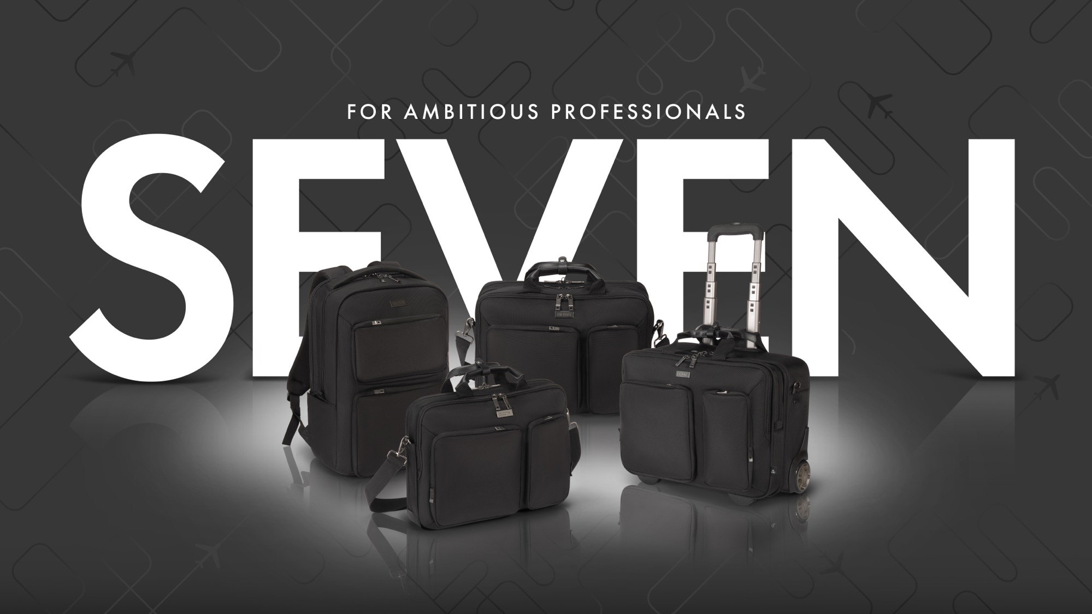

Slide 3
BEST IN CLASS.
BUILT FOR THE FUTURE.

Slide 4
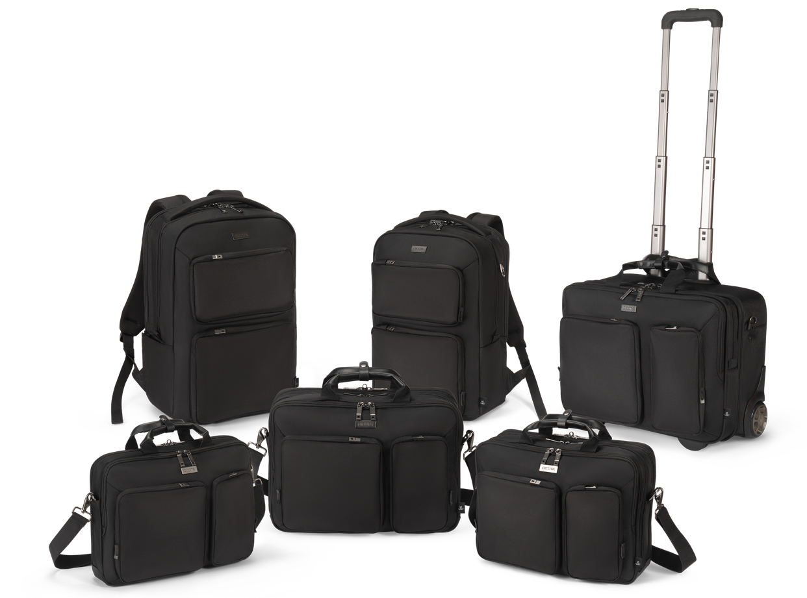
SEVEN

Slide 5
SEVEN – BEST IN CLASS. BUILT FOR THE FUTURE.
The SEVEN Series is the new flagship in the DICOTA portfolio – our most advanced line to date. It combines decades of expertise with the latest innovations and the clear vision of making mobile working safer, smarter, and more sustainable.
Developed from the strengths of the PRO Series and inspired by the real needs of today’s professionals, SEVEN delivers best-in-class functionality, protection, and design. Every detail has been carefully engineered: from DICOTA Cushion Technology and integrated RFID protection to a dedicated tracker compartment for added security.
What makes SEVEN truly stand out is its sustainability inside and out. The exterior and interior are both crafted from high-quality rPET materials, giving a second life to recycled plastic bottles while ensuring the durability and premium feel you expect from DICOTA.
The result is a series that sets new standards – durable, protective, and sustainable, without compromise.

Slide 6
SEVEN – HIGHLIGHTS
SEVEN is our absolute flagship product for business professionals with high standards in terms of quality,
durability, reliability, and functionality—combined with great design and the latest materials.
DICOTA Cushion Technology (DCT) integrated for perfect protection and fit of your notebook
Outer and inner material made from recycled PET bottles
Additional protection of the notebook through sturdy EVA panels
Main compartment for tablet, documents and folders
Interchangeable/customizable metal logo plate for branding
Metal D-ring with integrated T-Lock slot for attaching a notebook lock or hanging accessories
Waterproof bottom
Hidden tracker slot and RFID-safe pocket
Lockable zippers with ring lock
Trolley strap for convenient transport

Slide 7
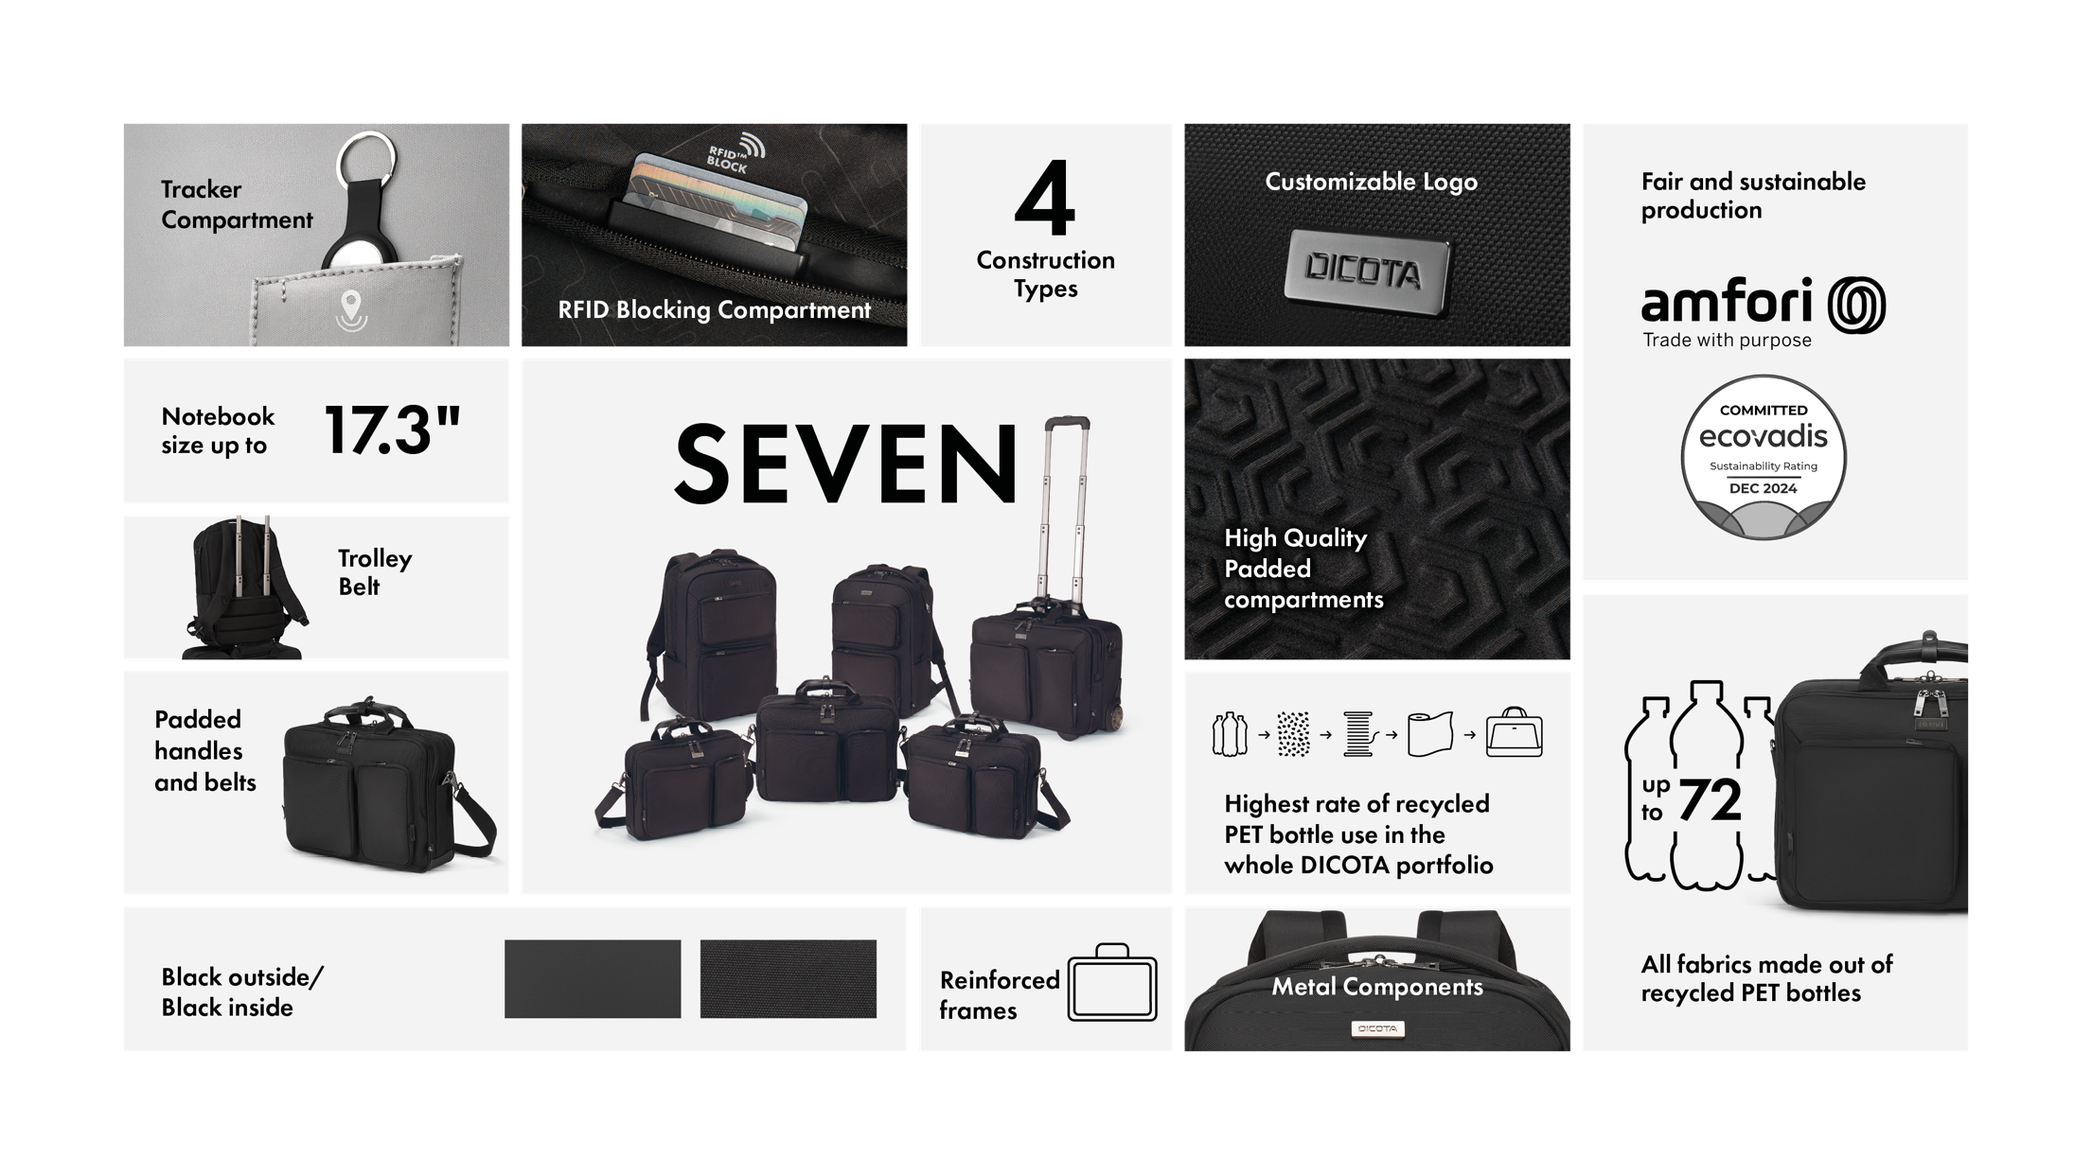

Slide 8
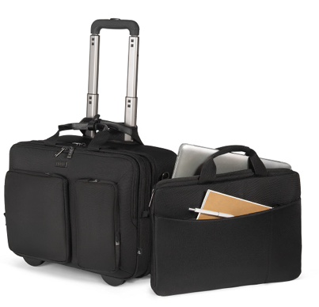
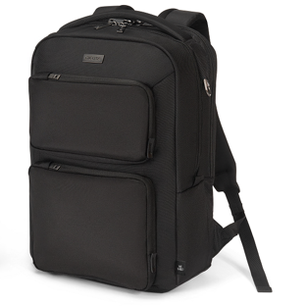
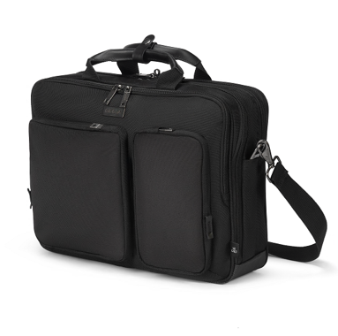
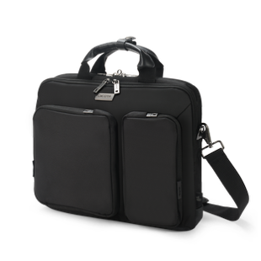
SEVEN – PORTFOLIO
  Four construction types to fit individual needs
  Fits notebooks up to 16“
  High functionality and sustainability
Backpack SEVEN
12-14 D3250101
14-16 D3250102
Top traveller SEVEN
12-14 D3250801
14-16 D3250802
Top traveller ROLLER SEVEN
14-16 D3250901
SLIM CASE SEVEN
12-14 D3250601

Slide 9
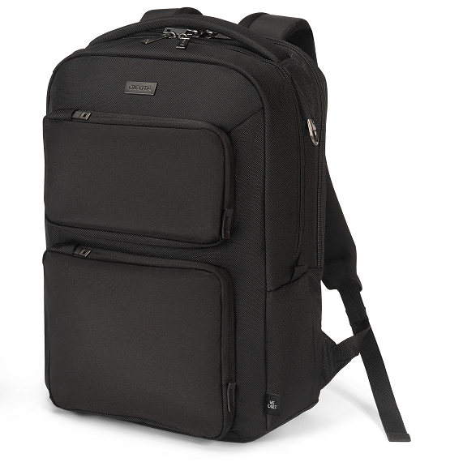
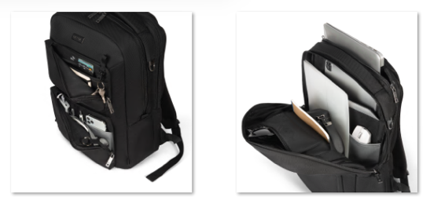
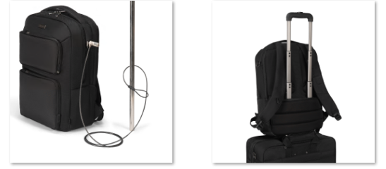
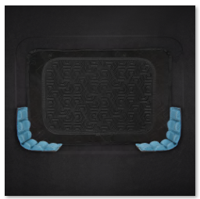
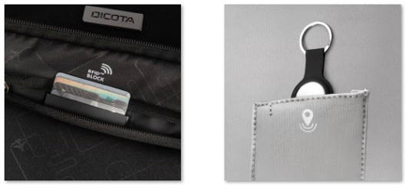
SEVEN – BACKPACKS
DICOTA Cushion Technology (DCT) integrated for perfect protection
Additional protection of the notebook through stable EVA panels - thus unique all-round protection
Outer and inner material made from 45/55 recycled PET bottles
Main compartment for tablet, documents and folders
Small additional pocket in the main compartment for best organization
Side pocket for umbrella or bottle
Breathable, ergonomic back padding
Trolley strap for convenient transport
Unobtrusive, wide carrying handle
Metal D-ring with integrated T-Lock slot for attaching a notebook lock
Lockable zippers with ring lock, hidden tracker slot, and RFID-secure pocket
Additional compartment on the back for storing documents and wallet
Waterproof bottom
Interchangeable/customizable metal logo plate for branding

Slide 10

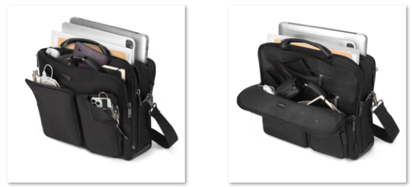
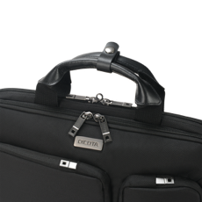
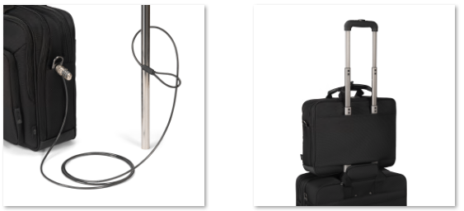
SEVEN – TOP TRAVELLER
DICOTA Cushion Technology (DCT) integrated for perfect protection
and fit of your notebook
Additional protection of the notebook through stable EVA panels –
thus unique all-round protection
Outer and inner material made from 39/44 recycled PET bottles
Main compartment for tablet, documents and folders
Trolley strap for convenient transport
Metal D-ring with integrated T-Lock slot for attaching a notebook lock
or hanging accessories
Lockable zippers with ring lock
Hidden tracker slot and RFID-safe pocket
Waterproof bottom
Replaceable/customizable metal logo plate for branding

Slide 11

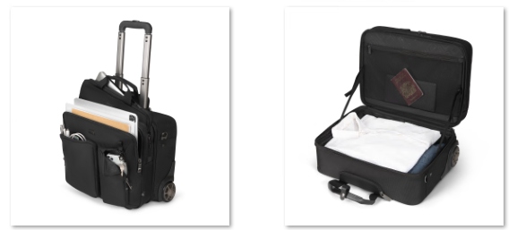
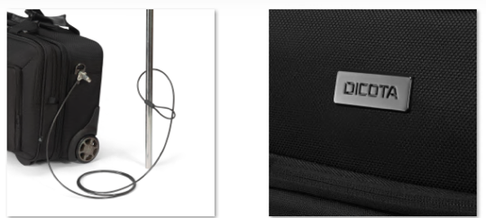
SEVEN – TOP TRAVELLER ROLLER
Removable slim case for the notebook
DICOTA Cushion Technology (DCT) integrated for perfect protection
Additional protection of the notebook through sturdy EVA panels –
thus unique all-round protection
Outer and inner material made from 65 recycled PET bottles
Main compartment for tablet, documents and folders
Trolley strap for convenient transport on other luggage
Metal D-ring with integrated T-Lock slot for attaching a notebook lock
Lockable zippers with ring lock, hidden tracker slot, and RFID-safe pocket
Waterproof bottom
Sturdy, four-piece trolley frame for comfortable use
Large wheels for comfortable and quiet rolling even over uneven roads
Linkage and wheels interchangeable if necessary
Replaceable/customizable metal logo plate for branding
Matches IATA regulations

Slide 12
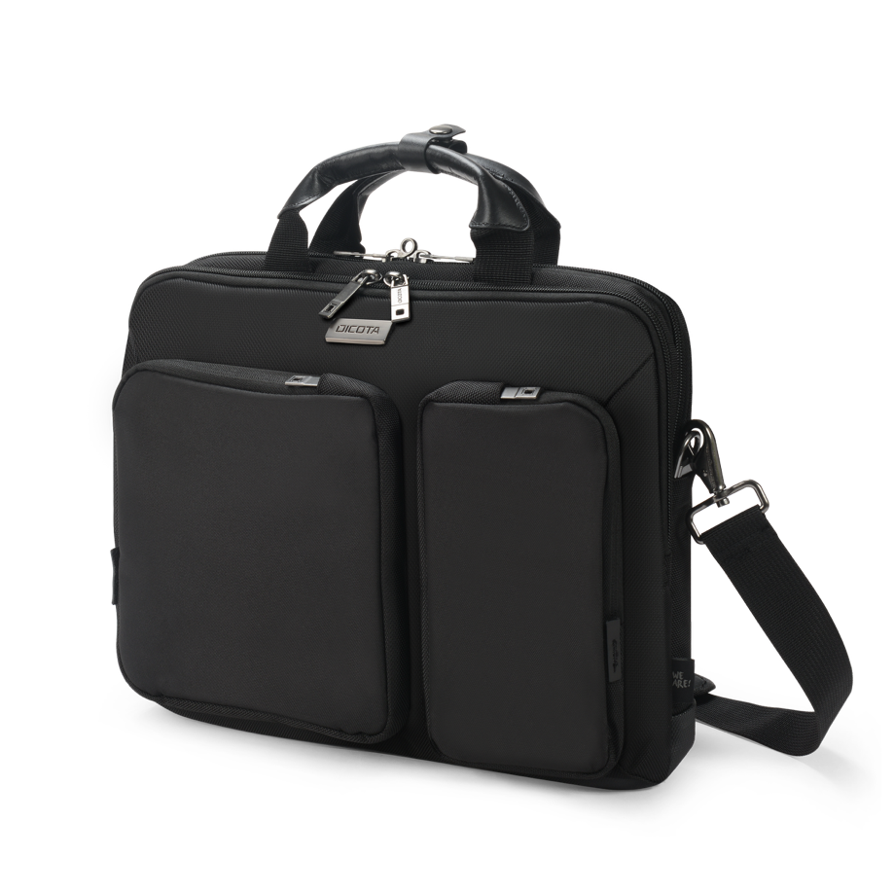
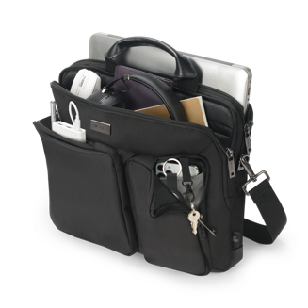
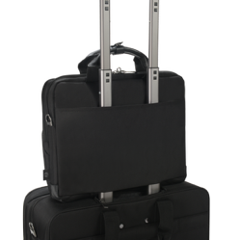
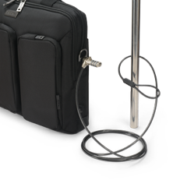
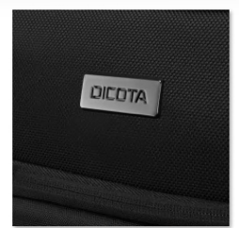
SEVEN – SLIM CASE
DICOTA Cushion Technology (DCT) integrated for perfect protection
and fit of your notebook
Additional protection of the notebook through stable EVA panels –
thus unique all-round protection
Outer and inner material made from 29 recycled PET bottles
Main compartment for tablet, documents and folders
Trolley strap for convenient transport
Metal D-ring with integrated T-Lock slot for attaching a notebook lock
or hanging accessories
Lockable zippers with ring lock
Hidden tracker slot and RFID-safe pocket
Waterproof bottom
Replaceable/customizable metal logo plate for branding

Slide 13
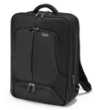
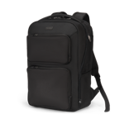
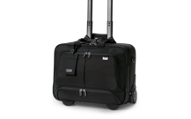
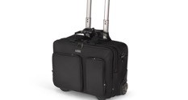
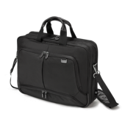
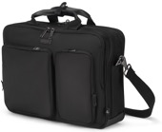
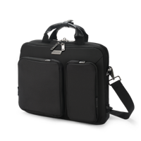
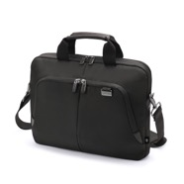
SEVEN – SUCCESSOR OVERVIEW
 | Item Code | Item Name |  | Item Code | Item Name
 | D30846-RPET | Eco Backpack PRO 12-14.1 | → | D3250101 | Backpack SEVEN 12-14
 | D30847-RPET | Eco Backpack PRO 15-17.3 | → | D3250102 | Backpack SEVEN 14-16
 | D30848-RPET | Eco Top Traveller Roller PRO 14-15.6 | → | D3250901 | Top Traveller Roller SEVEN 14-16
 | D30842-RPET | Eco Top Traveller PRO 12-14.1 | → | D3250801 | Top Traveller SEVEN 12-14
 | D30843-RPET | Eco Top Traveller PRO 14-15.6 | → | D3250802 | Top Traveller SEVEN 14-16
 | D30990-RPET | Eco Slim Case PRO 12-14.1 | → | D3250601 | Slim Case SEVEN 12-14

Slide 14
You never
work alone.
DICOTA SCHWEIZ AG
Churerstrasse 20, CH-8808 Pfäffikon SZ, Switzerland
www.dicota.com

