Slide 1
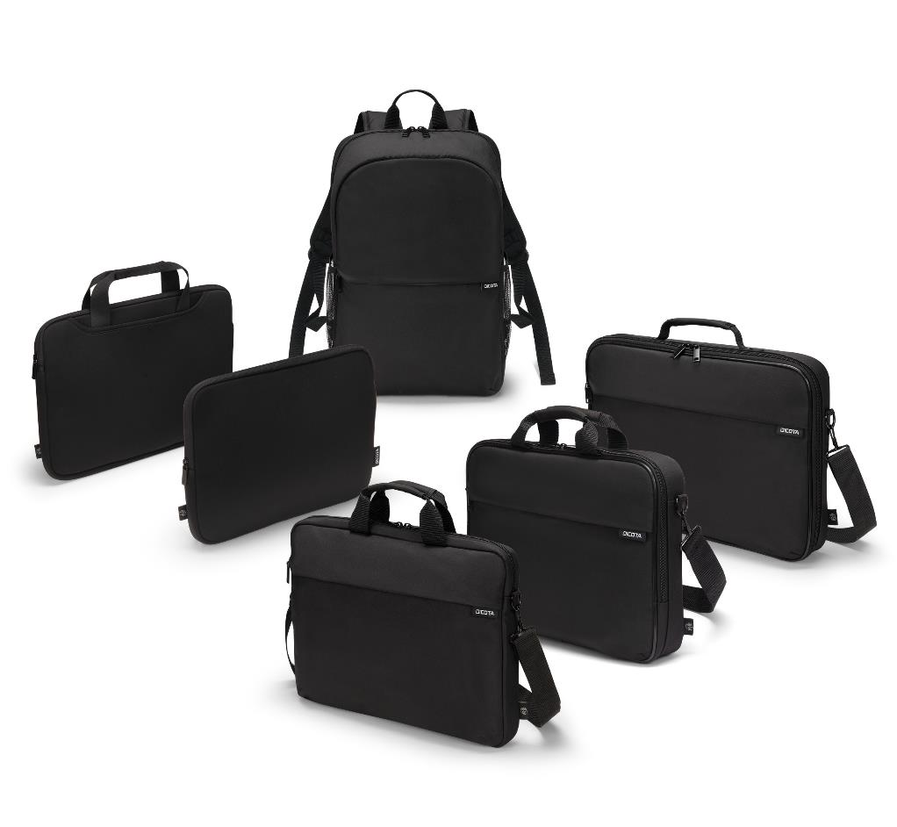
ONE
Quality, simplicity and sustainability for everyone
Notes:
EN: Quality, simplicity, and sustainability available to everyone.
DE: Qualität, Schlichtheit und Nachhaltigkeit - möglich für jeden
FR: La qualité, la simplicité et la durabilité sont à la portée de tous.

Slide 2
FAIR & SUSTAINABLE
Made from up to 28 recycled PET bottles and fairly produced.
AVAILABLE AT
ANY TIME
in large quantities
VERY GOOD PRICE-PERFORMANCE
5 YEARS
WARRANTY

Slide 3


QUALITY, SIMPLICITY AND SUSTAINIBILITY FOR EVERYONE
Welcome to the latest collection - ONE!
ONE is the new entry-level collection from DICOTA and stands out for good quality and sustainability. Each product is characterised by its simple design and clear functionality. Produced in a fair and socially sustainable way from recycled PET bottles, the collection appeals to anyone who appreciates good value for money and wants to be environmentally conscious.
Discover the new products in the ONE collection with us!

Slide 4
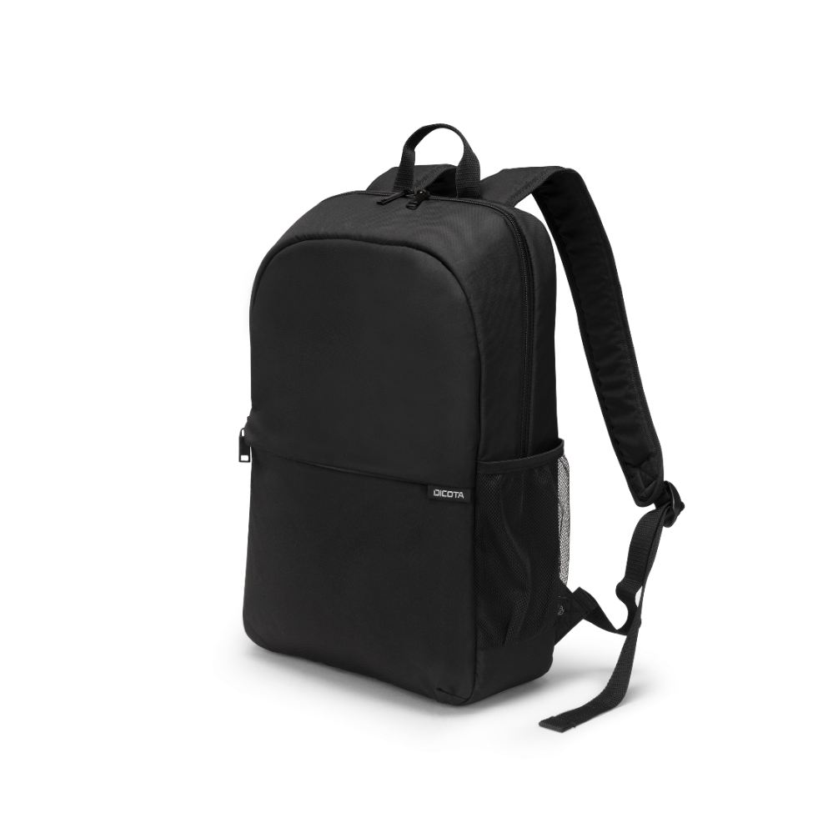
BACKPACK ONE
The Backpack ONE is equipped with a main compartment, two side pockets and a zip pocket on the front.The main compartment contains a padded notebook compartment with fastening straps and offers a total capacity of 15 / 20 litres for documents and personal items. A water bottle and umbrella can be conveniently stowed in the two side pockets. The zip pocket on the front offers additional space for mobile accessories, business cards, pens and much more. The backpack is equipped with two comfortable shoulder straps and a handy carrying handle for comfortable carrying. A simple and high-quality product for professional and private use.

Slide 5
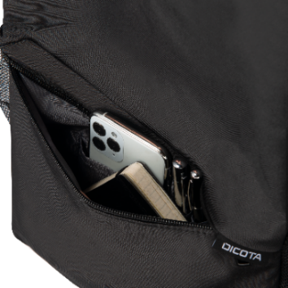
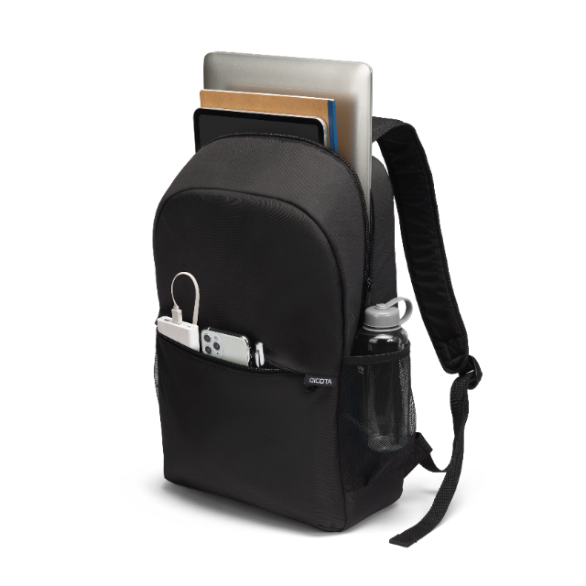
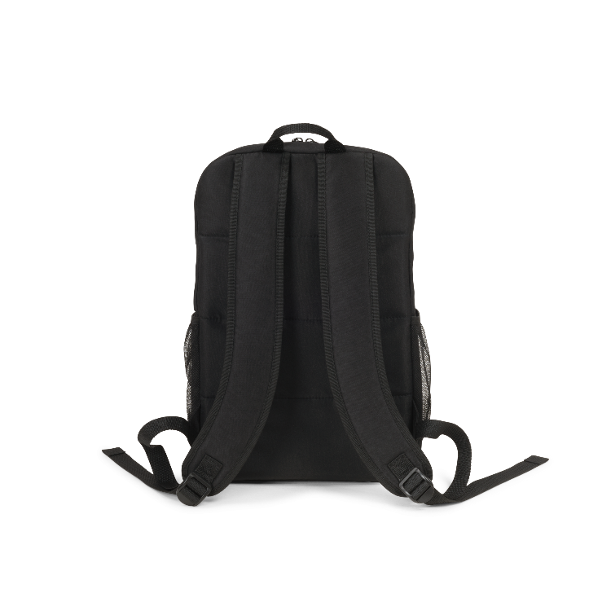
BACKPACK ONE
Made from 22/ 28 recycled PET bottles
15/ 20 litre capacityPadded main compartment
Slip-in compartment with fastening straps for notebooks
Front pocket with workstation for mobile accessories
Side pocket for umbrella or water bottle
Comfortable shoulder straps and handle
High-quality metal components
5 year guarantee
D32085-RPET Backpack ONE 13 – 16”
D32086-RPET Backpack ONE 15 – 17.3”

Slide 6
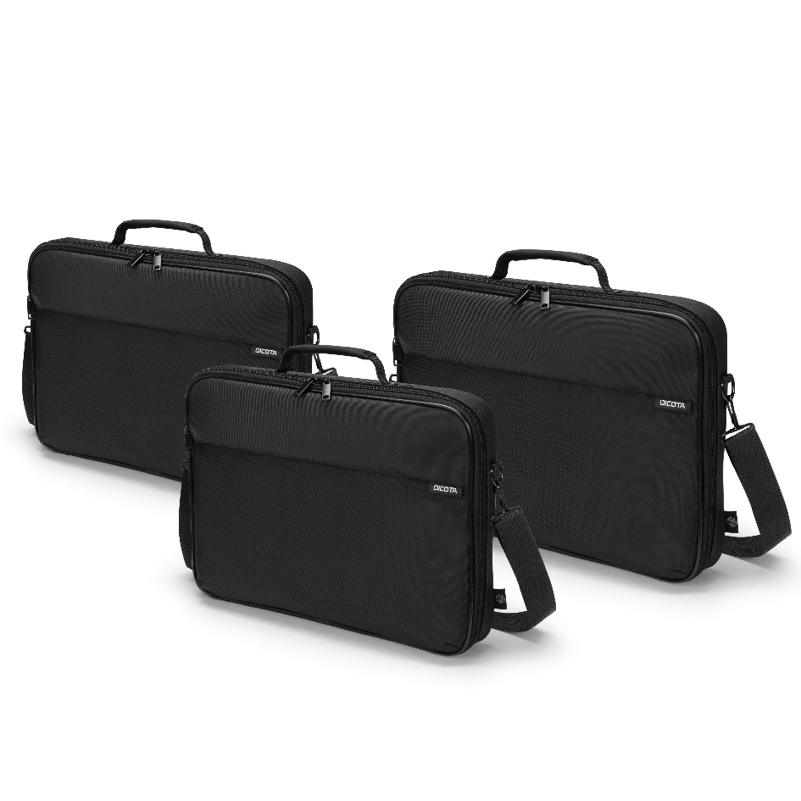
MULTI ONE
The Multi ONE is a fold-out clamshell bag with a particularly well-padded main compartment and a fastening strap that holds the notebook securely in place. A separate slip pocket offers space for documents, while the front pocket with zip is ideal for accessories, business cards and smartphones. The adjustable and detachable shoulder strap and the comfortable carrying handle ensure versatility and comfort. All in all, the Multi ONE is a bag with a simple design made from high-quality, sustainable materials that also allows for clear organisation.

Slide 7
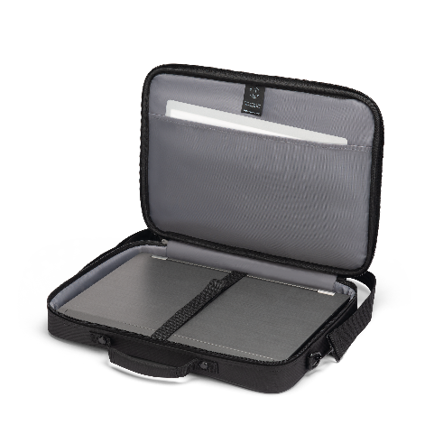
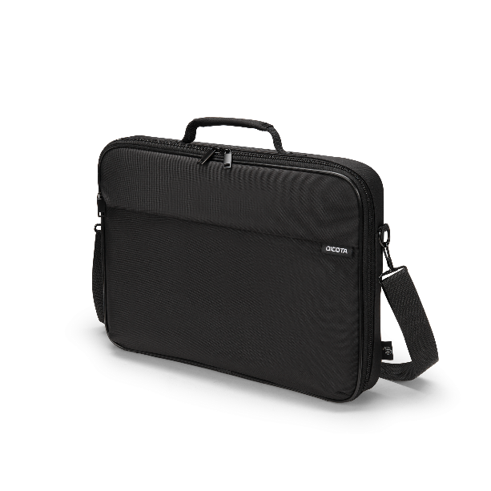
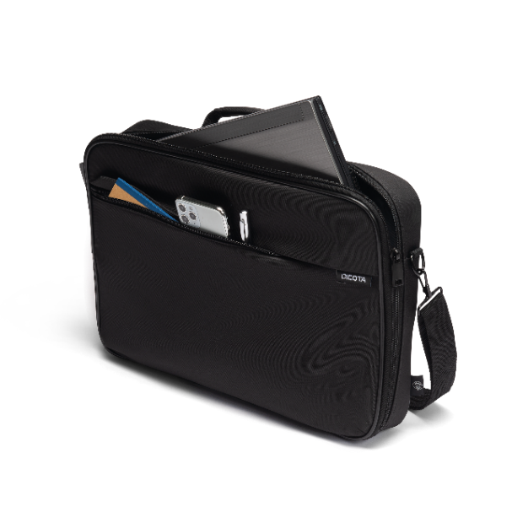
MULTI ONE
Made from 10/ 10.5 / 13 recycled PET bottles
Padded notebook compartment
Fastening strap ensures that the notebook does not slip
All-round padding for extra protection
Front pocket with workstation for mobile accessories
Comfortable carrying handle and detachable shoulder strap
High-quality metal components
5 year guarantee
D32087-RPET Multi ONE 13 – 14.1”
D32088-RPET Multi ONE 14 – 16”
D32089-RPET Multi ONE 15 – 17.3”

Slide 8
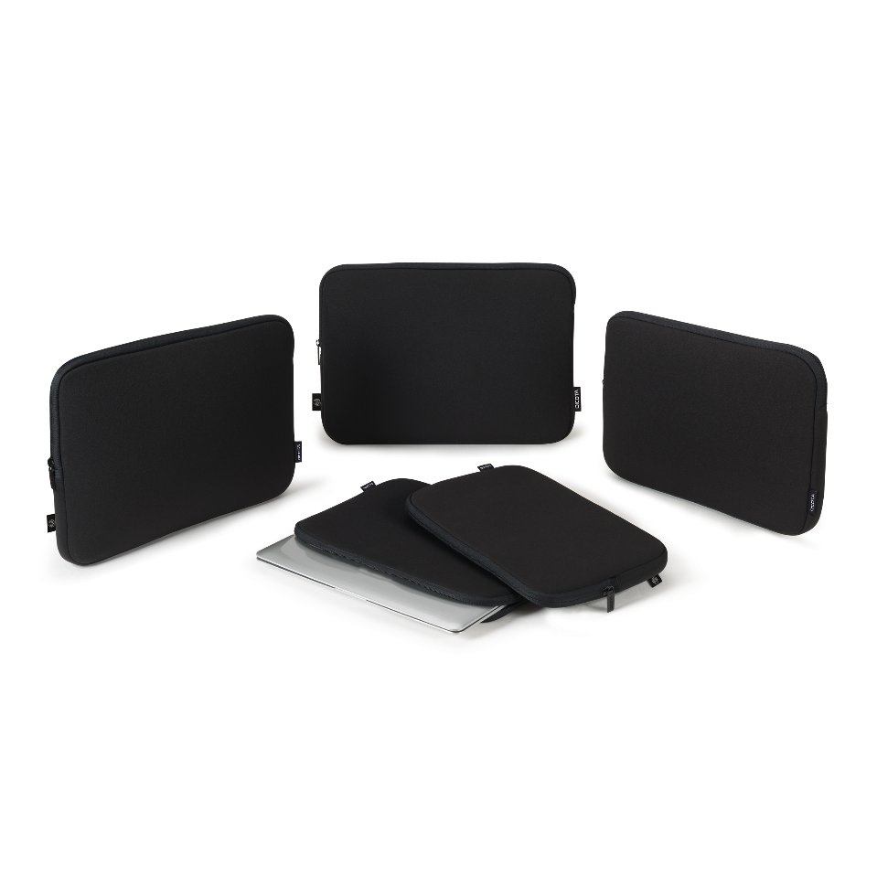
SLEEVE ONE
The sleeve reliably protects your notebook from damage thanks to its custom-fit shape and can easily be stowed in another piece of luggage as it takes up very little space. The spacious main compartment has a zip fastener with a protective layer on the inside to prevent scratches. It fits snugly around the device and thus offers optimum protection. Overall, the bag impresses with its lightweight, robust and simple design.

Slide 9
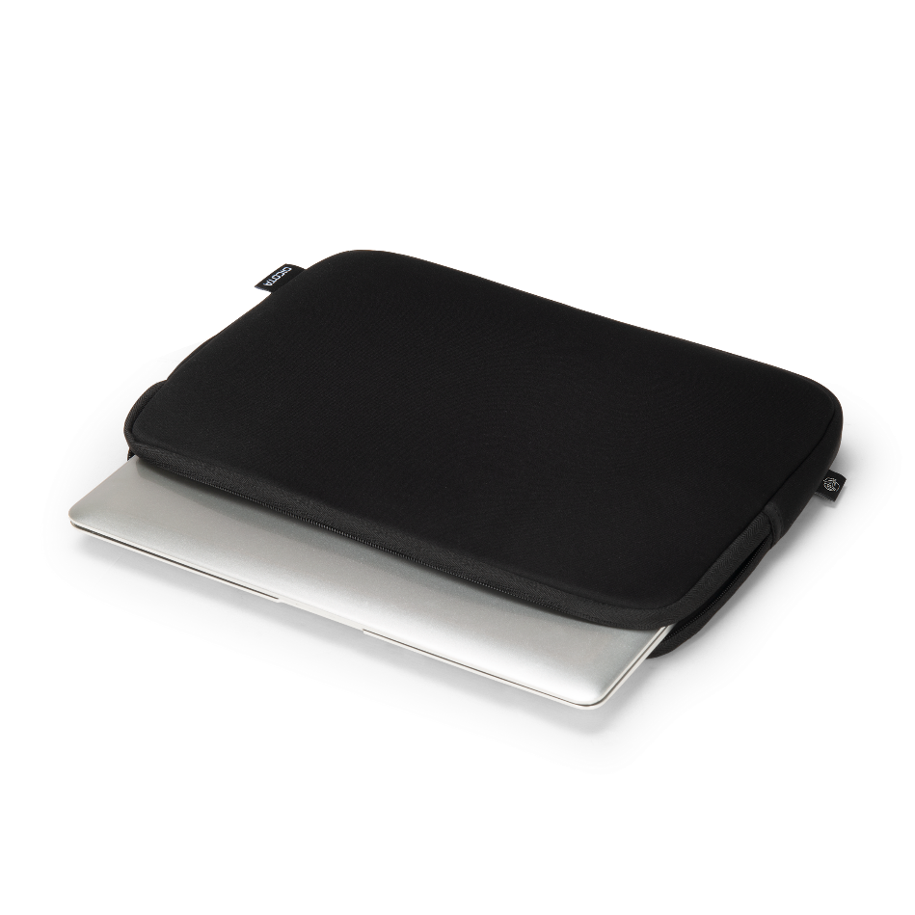
SLEEVE ONE
Mainly made from robust RPET material
Made from 1.5/ 2 recycled PET bottles
The elasticated material fits snugly around the laptop
High-quality metal zip
5 year guarantee
D32077-RPET Sleeve ONE 10 – 11.6”
D32078-RPET Sleeve ONE 12 – 12.5”
D32079-RPET Sleeve ONE 13 – 13.3”
D32080-RPET Sleeve ONE 14 – 14.1”
D32081-RPET Sleeve ONE 15 – 16”

Slide 10
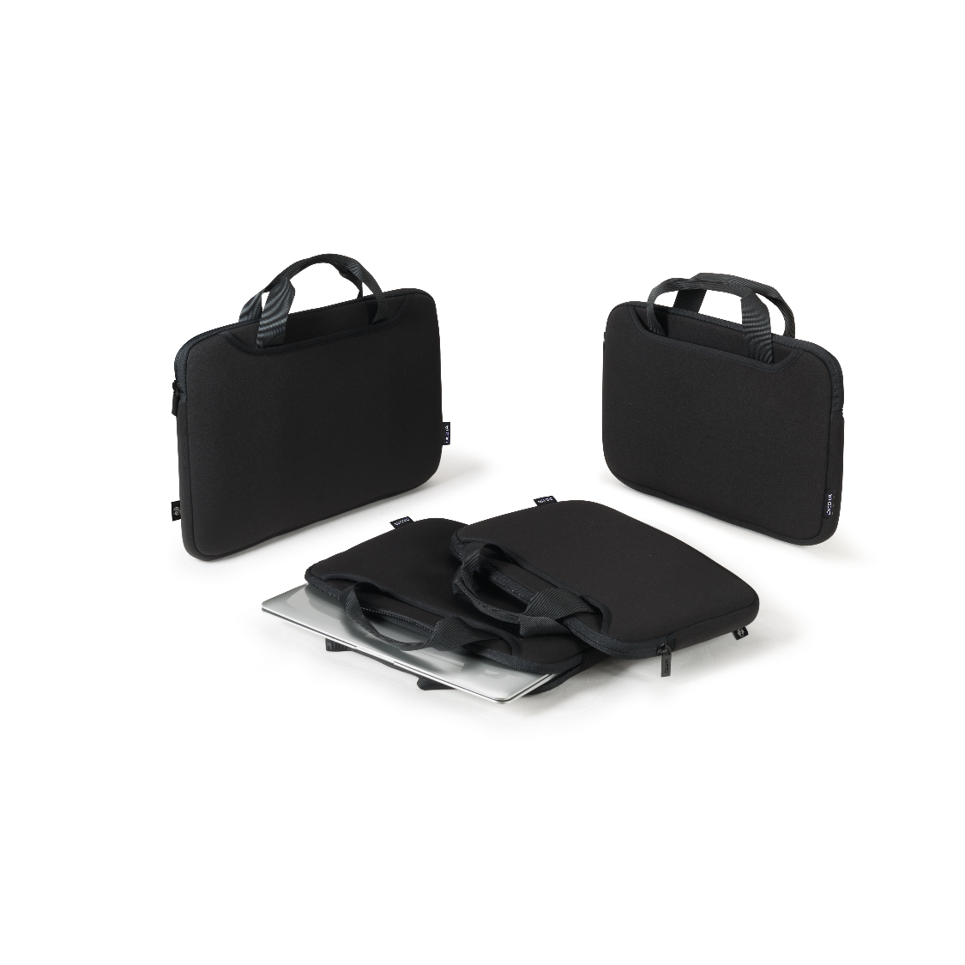
SMART SLEEVE ONE
The Smart Sleeve adds a practical carrying handle and an additional compartment for accessories to the classic sleeve. It reliably protects your notebook from damage and offers a convenient transport option thanks to the carrying handle. The spacious main compartment has a zip with a protective layer on the inside to prevent scratches. The additional compartment offers sufficient space for accessories such as charging cables, hubs and more. Thanks to the customised shape, the sleeve fits snugly around your device and offers optimum protection.

Slide 11
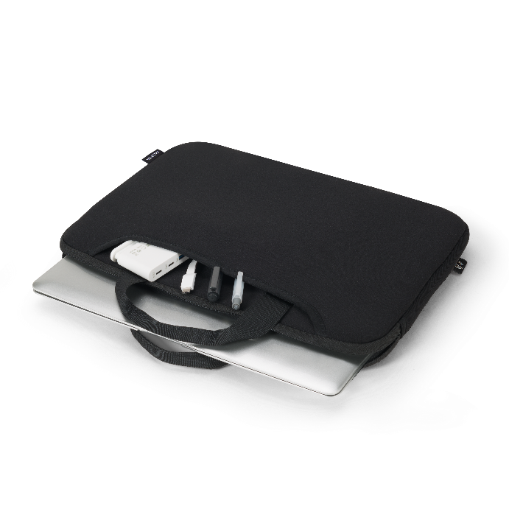
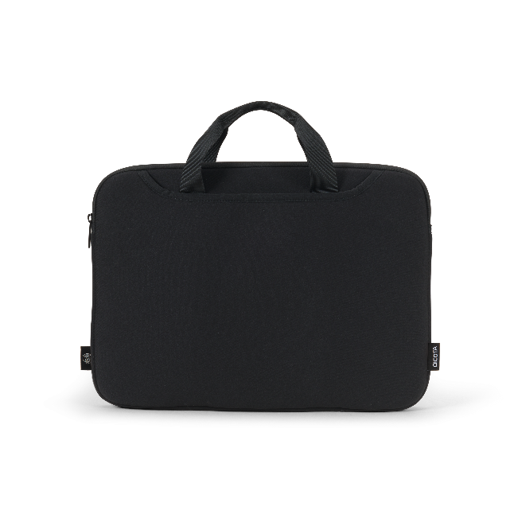
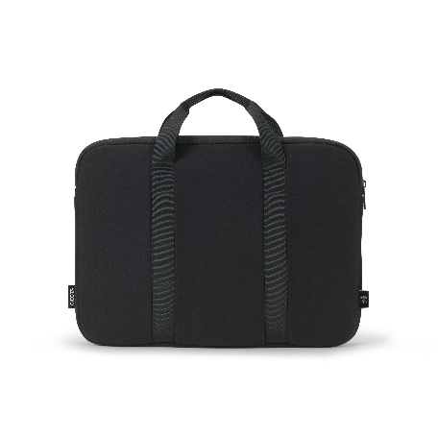
SMART SLEEVE ONE
Mainly made from robust RPET material
Made from 3 recycled PET bottles
The elasticated material fits snugly around the laptop
High-quality metal zip
5 year guarantee
D32082-RPET Smart Sleeve ONE 14 – 14.1”
D32081-RPET Smart Sleeve ONE 15 - 16”

Slide 12
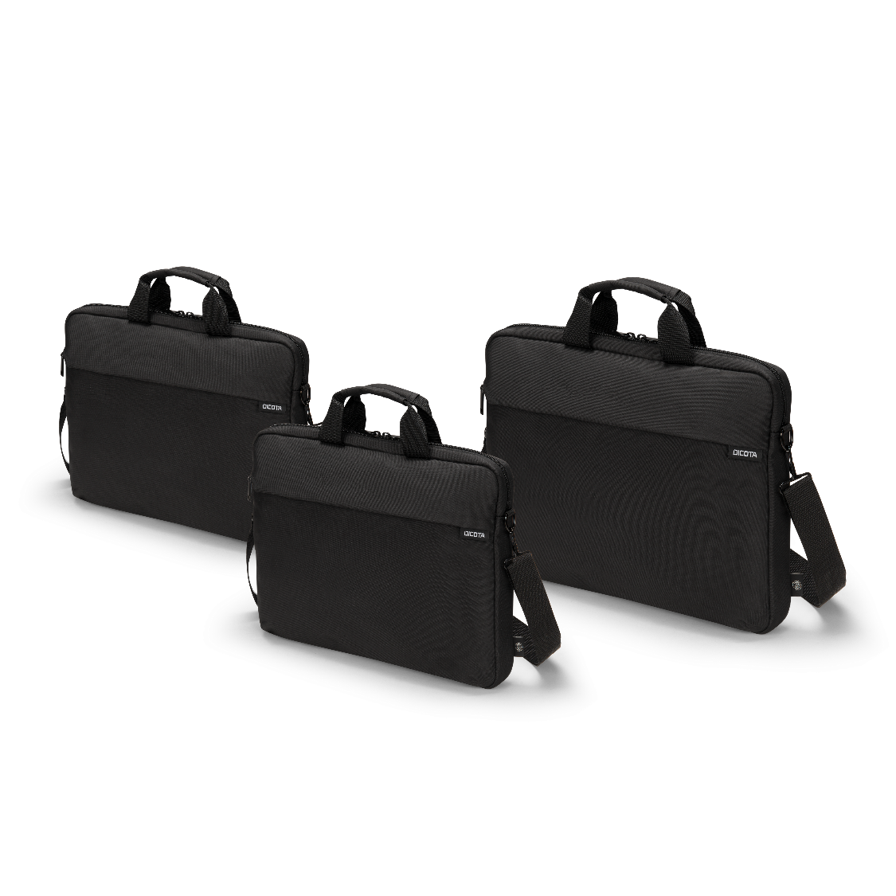
SLIM CASE ONE
The Slim Case bag offers storage space for your notebook and other accessories while remaining handy and slim in design. The main compartment with zip is particularly well padded so that the notebook stays securely in place. The front pocket with integrated workstation provides convenient space for mobile accessories. The comfortable, padded and detachable shoulder strap and the handy carrying handle provide additional carrying comfort. A simple but high-quality and well-equipped product, ideal for professional and private use.

Slide 13
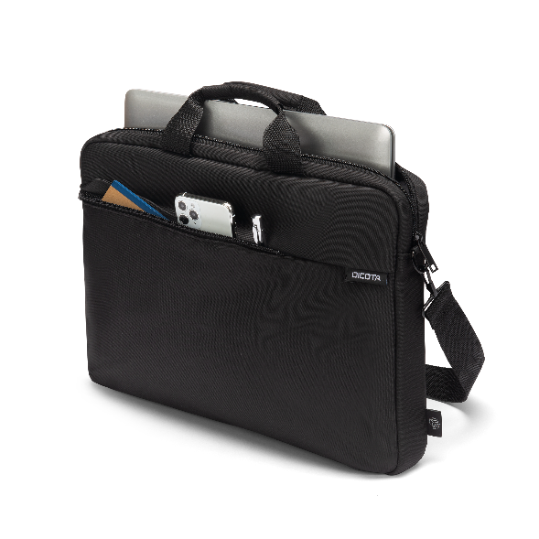
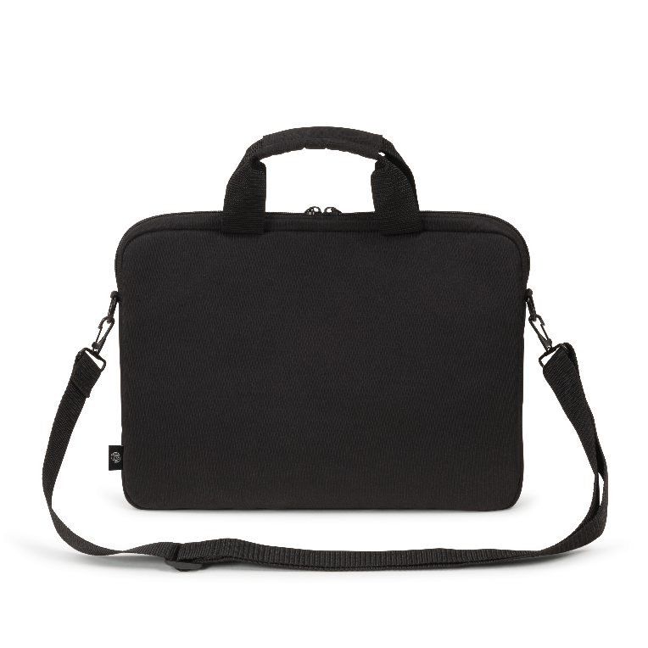
SLIM CASE ONE
Made from 7.5 / 9 / 10 recycled PET bottles
Padded notebook compartment
Front pocket with workstation for mobile accessories
Comfortable carrying handle and detachable shoulder strap
High-quality metal components
All-round padding for extra protection
5 year guarantee
D32090-RPET Slim Case One 10 – 12.5”
D32091-RPET Slim Case One 13 – 14.1”
D32092-RPET Slim Case One 14 – 16”
Notes:
5

Slide 14
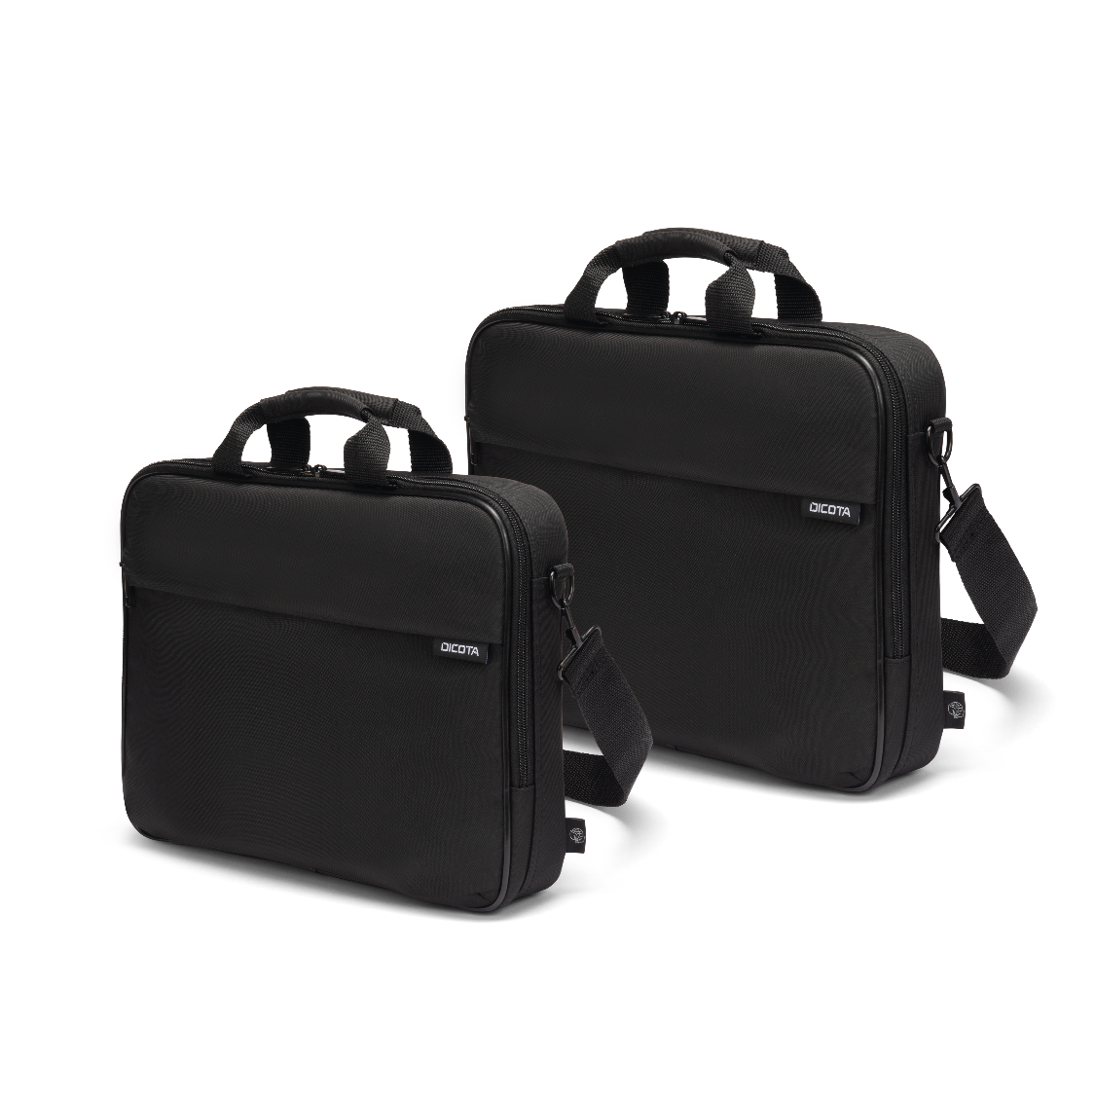
TOP TRAVELLER ONE
The Top Traveller impresses with plenty of space for your notebook, documents and other accessories. The main compartment with zip is particularly well padded so that the notebook stays securely in place. The front pocket with integrated workstation provides convenient space for mobile accessories. The comfortable, padded and detachable shoulder strap and the handy carrying handle provide additional carrying comfort. A simple, high-quality and sustainable product, ideal for professional and private use.

Slide 15
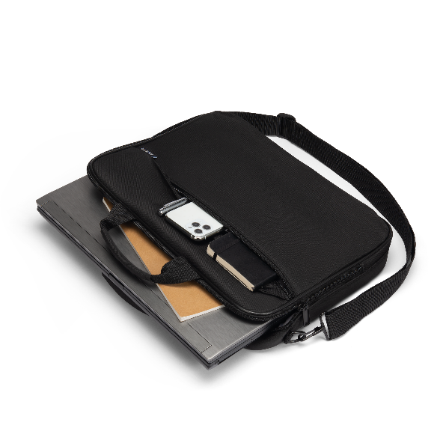
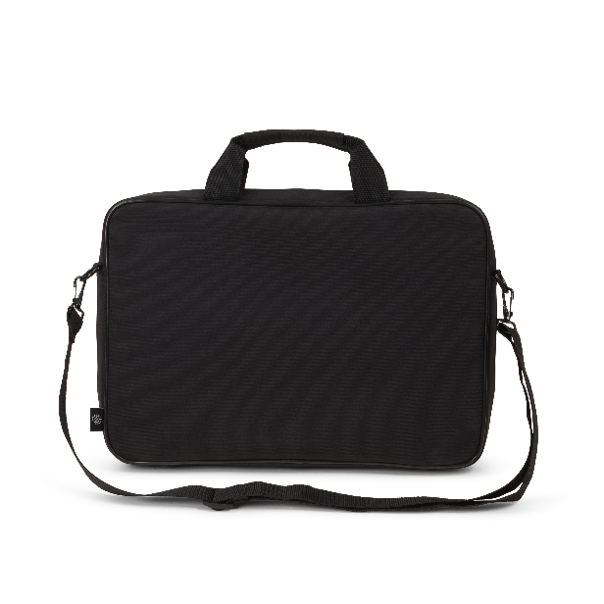
TOP TRAVELLER ONE
Made from 10 / 11.5 / 13 recycled PET bottles
Padded notebook compartment with fastening straps
Front pocket with workstation for mobile accessories
Comfortable carrying handle and detachable shoulder strap
High-quality metal components
All-round padding for extra protection
5 year guarantee
D32093-RPET Top Traveller One 13 – 14.1”
D32094-RPET Top Traveller One 14 –16”
D32099-RPET Top Traveller One 15 – 17.3”

Slide 16
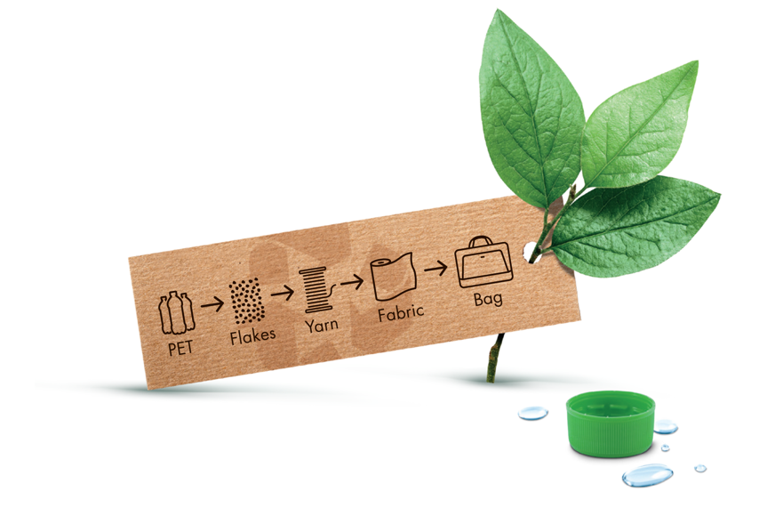

SUSTAINABILITY
Today's actions shape tomorrow's world. For this reason, DICOTA is focussing on the development of environmentally friendly carrying solutions. All products in the Eco collections are made from recycled PET.
Conservation of resources through high-quality and durable products
All products are 100% free from harmful PVC
Production fully complies with the European REACH standard
amfori BSCI-certified to improve social performance in global supply chains

Slide 17
AT YOUR SERVICE
THANK YOU FOR YOUR ATTENTION
DICOTA SWITZERLAND AG
Churerstrasse 20
CH-8808 Pfäffikon SZ
Phone +41 55 416 50 30
Fax +41 55 416 50 39
www.dicota.com

