Slide 1
THE NEW BACKPACK
LINE-UP
VERSATILITY FOR EVERY LIFESTYLE!

Slide 2
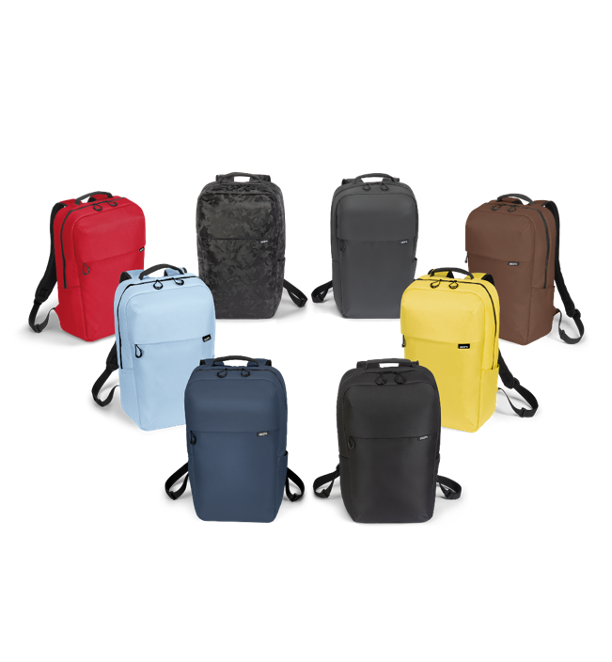
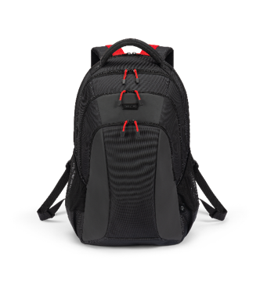
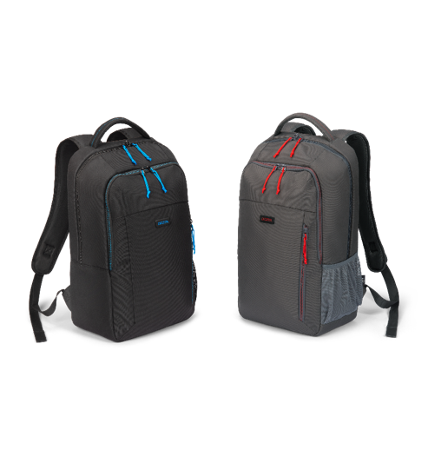
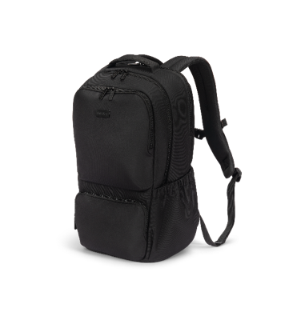
VERSATILITY FOR EVERY LIFESTYLE
The new range of backpacks offers something for every need and lifestyle. The lightweight and simple COMMUTER is ideal for the daily commute to work or for leisure activities. Choose from colourful designs, high visibility and robust construction. The COMPANION is ready for any adventure with excellent ergonomics and practical features. The SEEKER II offers plenty of storage space and great organization for long journeys, while the SPIN II combines quality and sustainability at an unbeatable price.
Whether for work, study or leisure, discover the backpack that perfectly suits your lifestyle.
COMPANION
SPIN II
SEEKER II
COMMUTER

Slide 3
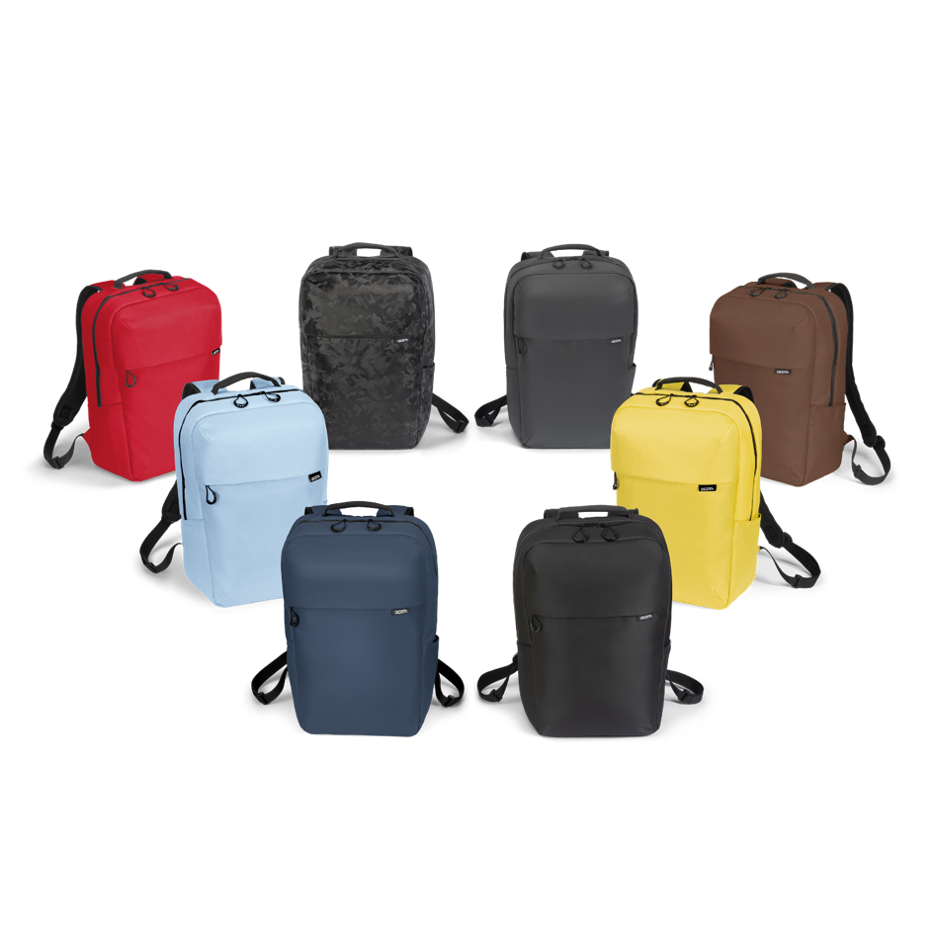
COMMUTER
The COMMUTER is the ideal backpack for those who need plenty of space and essential features for work, school or short trips. Available in a wide range of colours to match your style, it offers simple functionality and lightweight design for everyday travel. For added versatility, the COMMUTER comes in special versions. The COMMUTER Camo combines durability with a unique camouflage pattern, perfect for daily commuting and active leisure. COMMUTER Reflective enhances safety with fully reflective material that ensures high visibility in low light conditions, making it a reliable companion day and night.
CAMO
REFLECTIVE
RED
BROWN
ICE BLUE
LIME
NAVY
BLACK

Slide 4
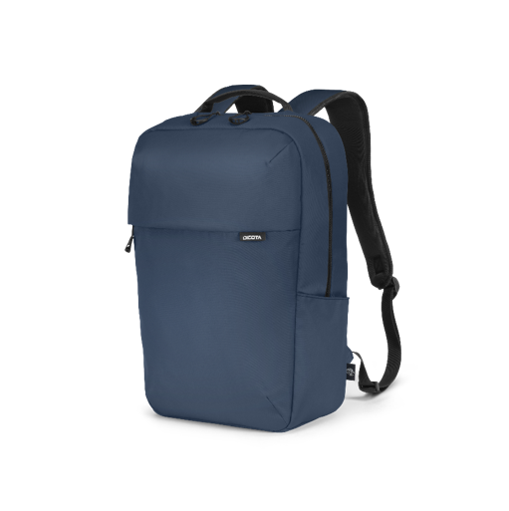
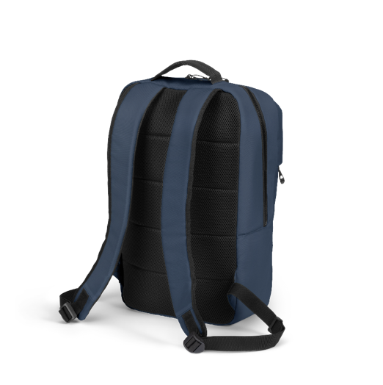
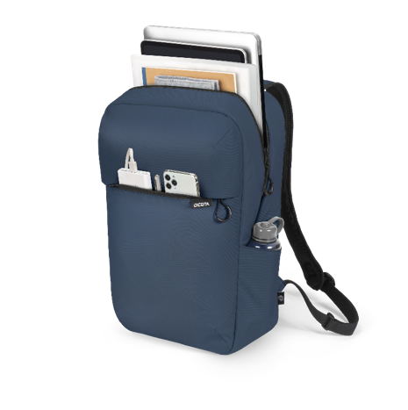
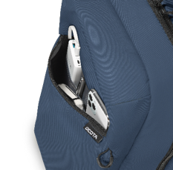

COMMUTER COLOURS
Spacious main compartment for13-16” notebooks,
documents or personal items
Front pocket with workstation
Zippers with loop for easy access
Right-side pocket perfect for a water bottle
or small items
Comfortable back padding
Padded shoulder straps
Made fairly and sustainably from 7 recycled PET bottles

Slide 5

COMMUTER COLOURS
Available in a range of colours:
D32115-RPET Backpack COMMUTER Black
D32120-RPET Backpack COMMUTER Navy Blue
D32121-RPET Backpack COMMUTER Red
D32122-RPET Backpack COMMUTER Ice Blue
D32123-RPET Backpack COMMUTER Lime
D32124-RPET Backpack COMMUTER Brown
RED
BROWN
ICE BLUE
LIME
NAVY
BLACK

Slide 6
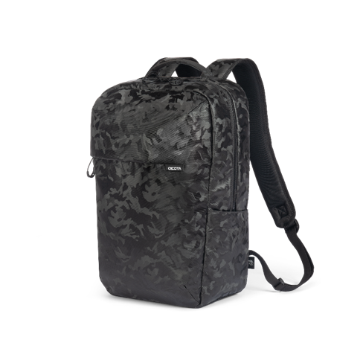
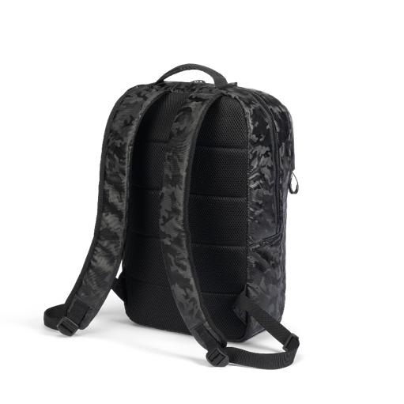
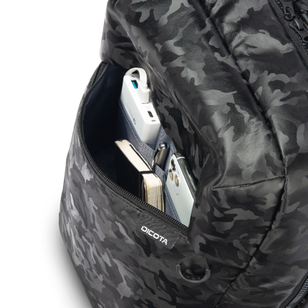
COMMUTER CAMO
Water repellent material
Spacious main compartment for 13-16” notebooks, documents or personal items
Front pocket with workstation
Zippers with loop for easy access
Right-side pocket perfect for a water bottle
or small items
Comfortable back padding
Padded shoulder straps
D32126 Backpack COMMUTER Camo

Slide 7
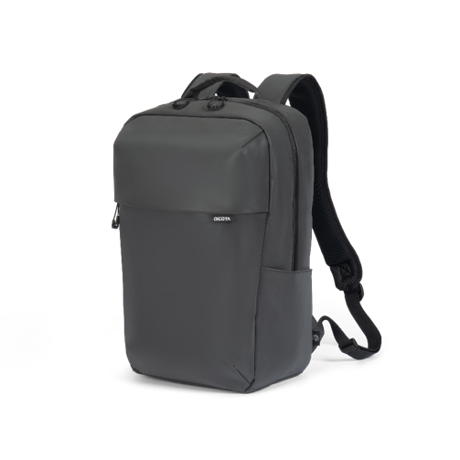
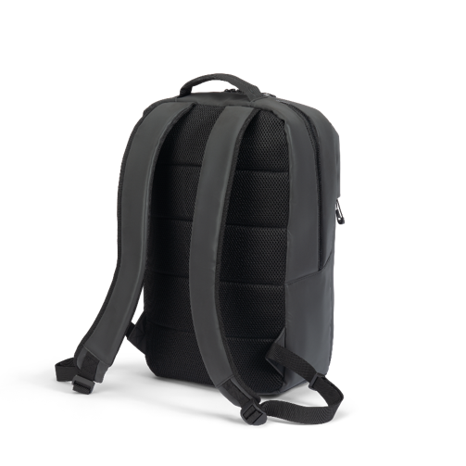
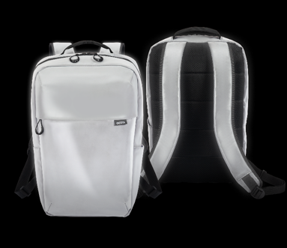
COMMUTER REFLECTIVE
Full reflective material for enhanced safety –’perfect for the dark season’
Spacious main compartment for 13-16” notebooks, documents or personal items
Front pocket with workstation
Zippers with loop for easy access
Right-side pocket perfect for a water bottle
or small items
Comfortable back padding
Padded shoulder straps
D32125 Backpack COMMUTER Reflective

Slide 8
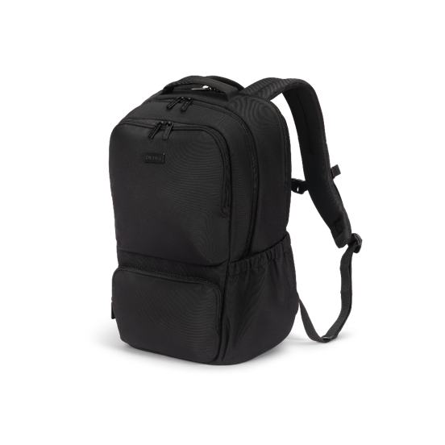
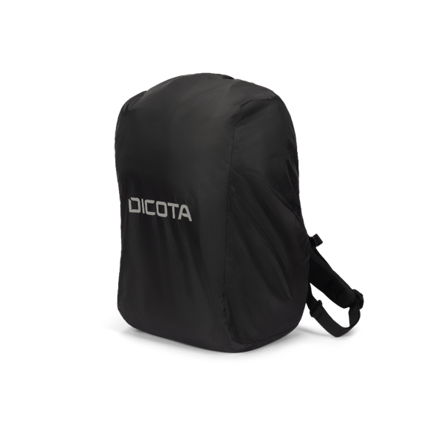
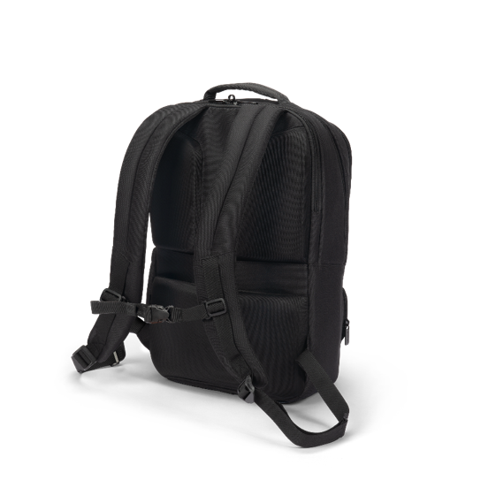
COMPANION
The COMPANION backpack combines maximum functionality with style.
With well thought-out features such as a chest strap, an integrated rain cover and a security pocket that doubles as a trolley attachment, your most important items are well protected and always ready to hand – no matter where the day takes you. Made from high-quality materials, ergonomically optimised and at an attractive price, the COMPANION impresses with its classic design and outstanding performance. Whether you’re travelling to work, exploring new places or enjoying leisure activities, this backpack will be your reliable companion.

Slide 9
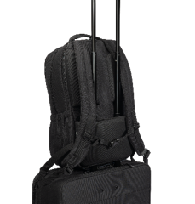
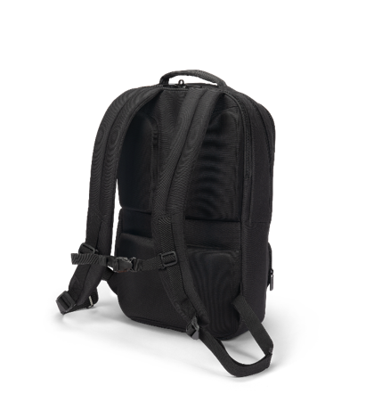
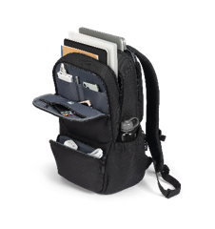
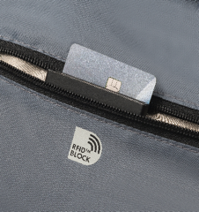
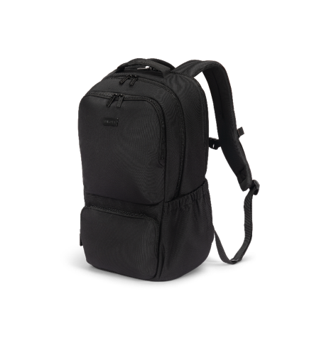
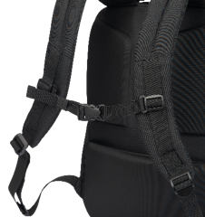
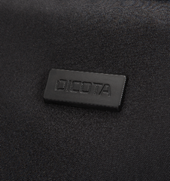
COMPANION
Two slip-in pockets for 13-16” notebooks and documents
Front pocket with workstation and RFID pocket with zipper
Elastic mesh zip pocket for equipment
Breast and optional hip belt
Hidden pocket doubles as trolley belt
Right side pocket perfect for a water bottle or small items
Ergonomic back padding and padded shoulder straps
Rain cover with reflective DICOTA logo in silver-grey
Metal logo on the front for individualization
Made fairly and sustainably from 11 recycled PET bottles
D32116-RPET Backpack COMPANION

Slide 10
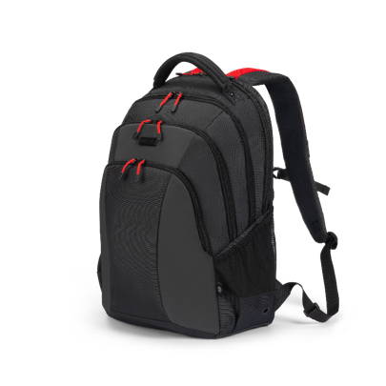
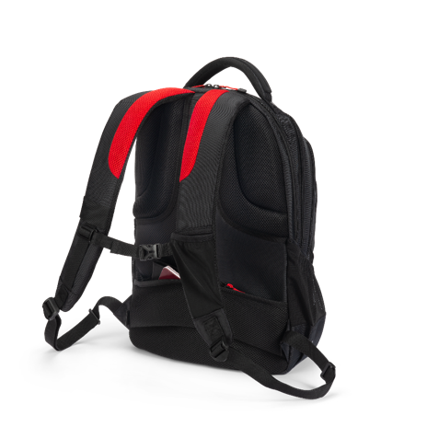
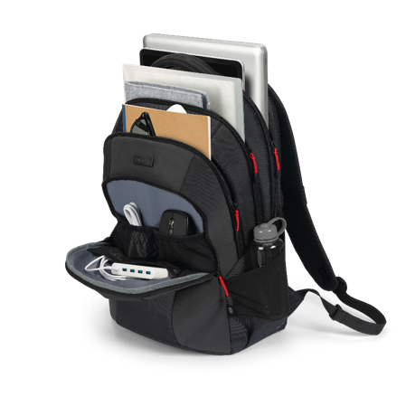
SEEKER II
The SEEKER II backpack is an everyday all-rounder – designed for anyone who travels a lot and carries a lot.
With well thought-out compartments and plenty of space, it allows you to keep your equipment organized and easily accessible. Whether it is a bulky notebook, daily essentials or special accessories – the SEEKER II offers you the perfect solution for safe and convenient transport. Let it support you on your journey and experience how it optimises your mobility.

Slide 11
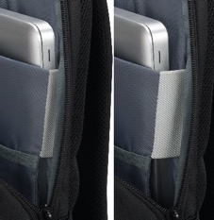
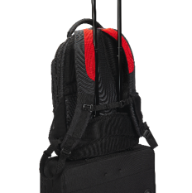
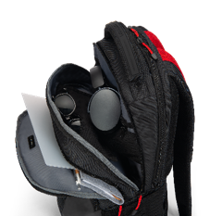
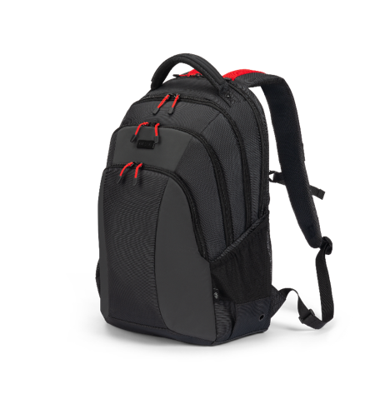
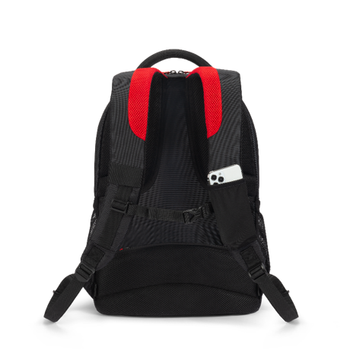
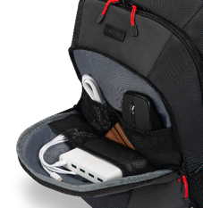
SEEKER
Notebook compartment for 13-16” devices with fitall-system and lockable YKK security zipper, plus a tablet pocket in front.
Two slip-in pockets for documents or personal items
Front pocket with workstation
Left side pocket with loop, elasticated pocket on the right
Hidden pocket doubles as trolley belt
Padded shoulder strap with chest belt and elastic smartphone pocket
Metal logo on the front for individualization
Made fairly and sustainably from 20 recycled PET bottles
D32119-RPET Backpack SEEKER II

Slide 12

SPIN II
The SPIN backpack impresses with its spacious design and details.
Colourful accents give it a fresh but unstated touch. Whether for work or personal use, the SPIN II backpack is functional, reliable and an affordable choice for anyone who values sustainability and quality.

Slide 13
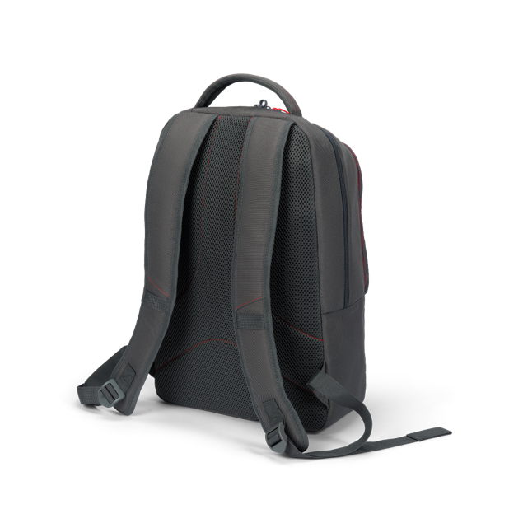
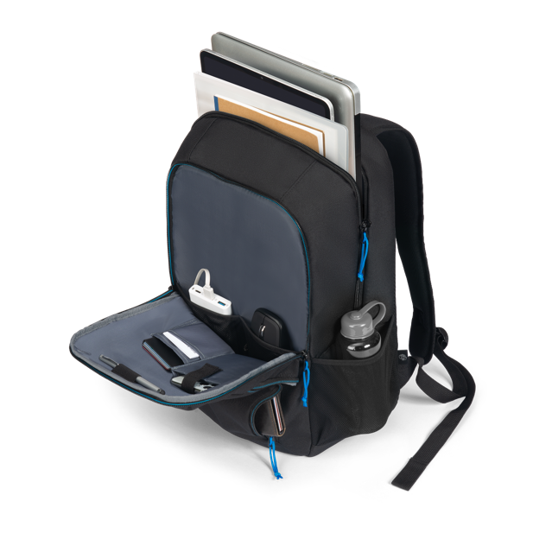
SPIN II
Large main compartment with padded pocket for notebook and extra space for documents
Front pocket with workstation
Small pocket with vertical zip for small items
Soft mesh pocket on the right side for water bottle
Padded back and shoulder strap with webbing loop and decorative stitching
Metal logo on the front for customization options
Made fairly and sustainably from 9 recycled PET bottles
D32117-RPET Backpack SPIN II blue
D32118-RPET Backpack SPIN II red

Slide 14
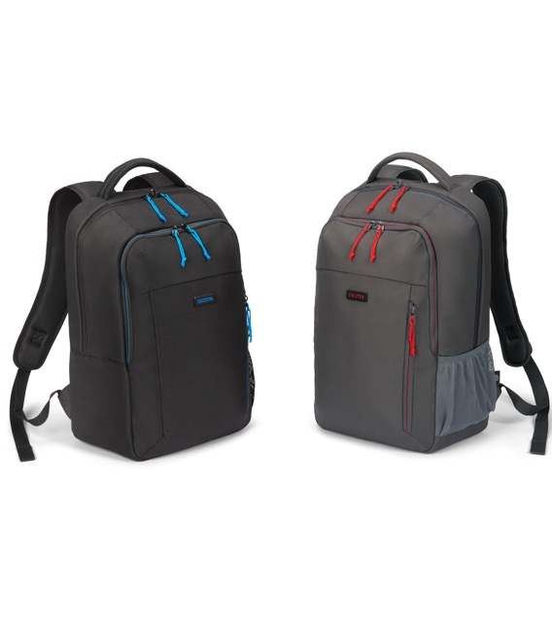
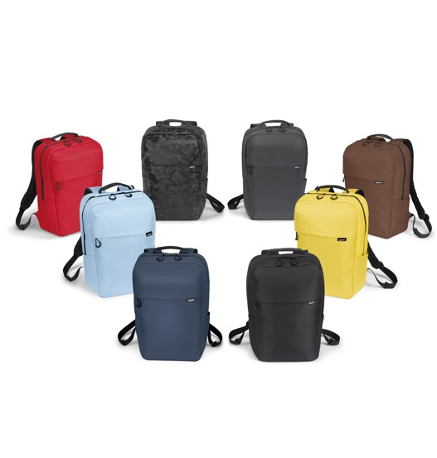
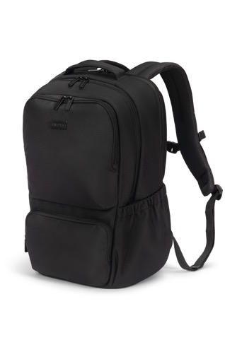
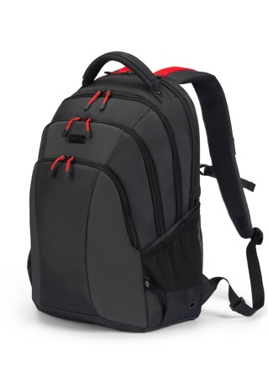
Find the backpack that perfectly suits your lifestyle.
COMMUTER
COMPANION
SEEKER II
SPIN II

Slide 15
Find the backpack that perfectly suits your lifestyle.
COMMUTER
COMPANION
SEEKER II
SPIN II
D32115-RPET
D32120-RPET
D32121-RPET
D32122-RPET
D32123-RPET
D32124-RPET
D32126
D32125
Black
Navy Blue
Red
ICE Blue
LIme
Brown
Camo
Reflective
D32116-RPET
Black
D32119-RPET
Black
D32117-RPET
D32118-RPET
BlUE
RED

Slide 16
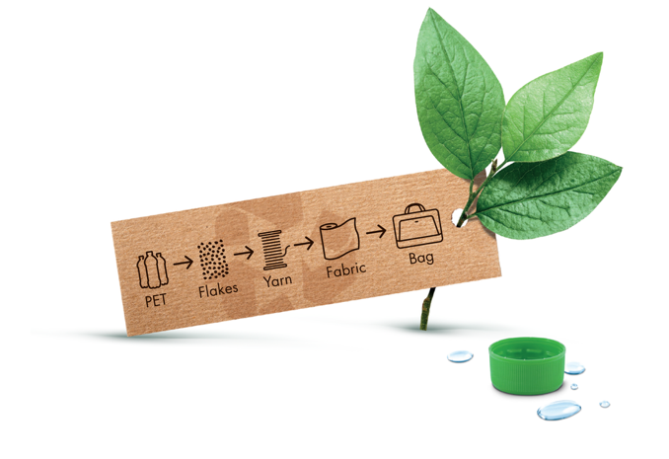

SUSTAINIBILITY
Our actions today shape the world of tomorrow. That's why DICOTA favours ecologically sound solutions and manufactures all ECO collections from sustainable recycled PET.
Conservation of resources through high-quality and durable products
All products are 100% free from harmful PVC
Production fully complies with the European REACH standard
Amfori BSCI-certified to improve social performance in global supply chains

Slide 17
AT YOUR
SERVICE
THANK YOU FOR
YOUR ATTENTION
DICOTA SWITZERLAND AG
Churerstrasse 20
CH-8808 Pfäffikon SZ
Phone +41 55 416 50 30
Fax +41 55 416 50 39
www.dicota.com

