Slide 1
FIVE
PERFORMANCE AND SECURITY IN EVERY PERSPECTIVE
03/2025

Slide 2
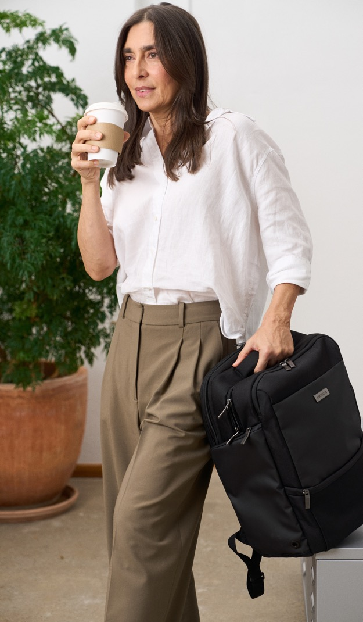
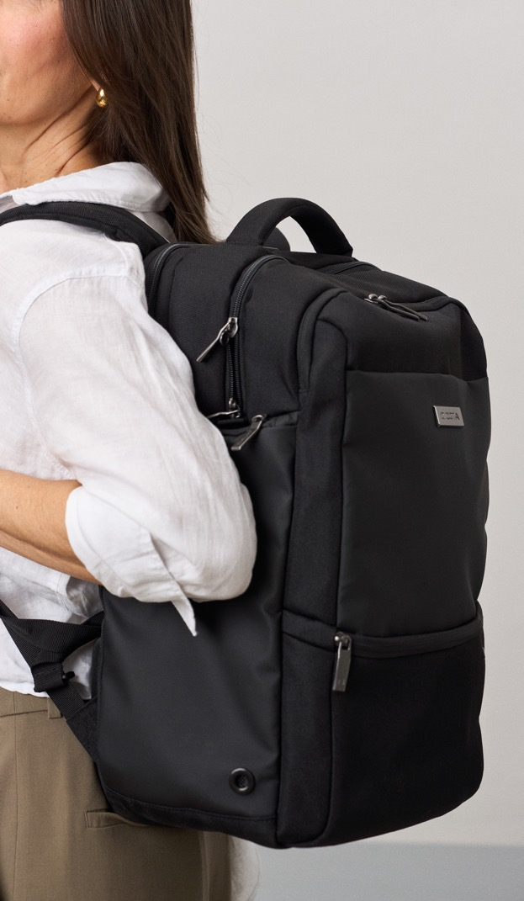
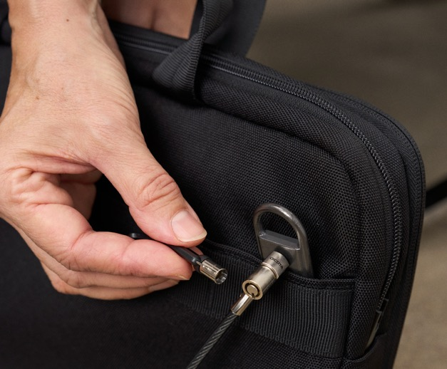
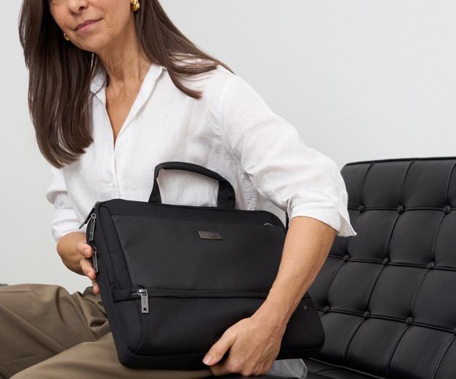

Slide 3
FIVE – THE CONCEPT
The FIVE is the natural evolution of DICOTA's business line. It follows the new, simplified naming strategy introduced with ONE as DICOTA's entry into professional carrying solutions and now with the all-new FIVE as a professional line for discerning business travelers.
It sits between the SELECT and PRO ranges and is aimed at ambitious professional consumers who need more than just a bag – they need a mobile office. FIVE combines reliable performance with enhanced security and practical comfort. The use of durable, recycled materials now extends to the interior of the bag, while the black and beige color scheme improves visibility and organization inside the bag. A well-structured front compartment provides quick access to power adapters and cables and helps prevent pressure points and display damage.
The notebook compartment features a self-closing zipper to prevent theft and DCT padding for reliable shock protection. A separate document compartment, additional space for accessories or a second device and new ergonomic features – including a trolley strap and a shoulder strap holder that doubles as a clasp – round off the design for everyday mobility. An integrated RFID protection secures passports and credit cards, while a special slot for tracking devices ensures that the bag can be located if misplaced.
FIVE is made for professionals who value efficiency, protection, and sustainability in every detail.

Slide 4
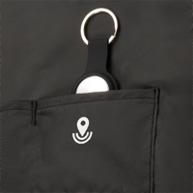
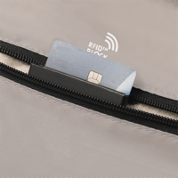
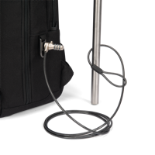
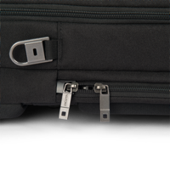
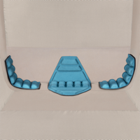
FIVE – THE KEY FUNCTIONS
Durable, recycled materials - for the first time also in the interior - sustainable!
The front compartment allows quick access to the power supply and cables, protects the notebook from pressure marks and display damage. A slot for tracking devices allows the bag to be tracked - should the bag be forgotten, misplaced or even stolen.
Other compartments offer space for accessories, documents or an additional notebook/tablet. The notebook compartment with self-closing zipper makes theft more difficult and is equipped with high-density foam or DCT padding. The black-beige interior makes it easy to identify accessories.
Ergonomic handles, shoulder straps and a trolley attachment are standard features. A newly developed shoulder strap holder also allows the bag to be secured with a notebook lock - secure! An additional compartment with RFID protection secures passports and credit cards.

Slide 5
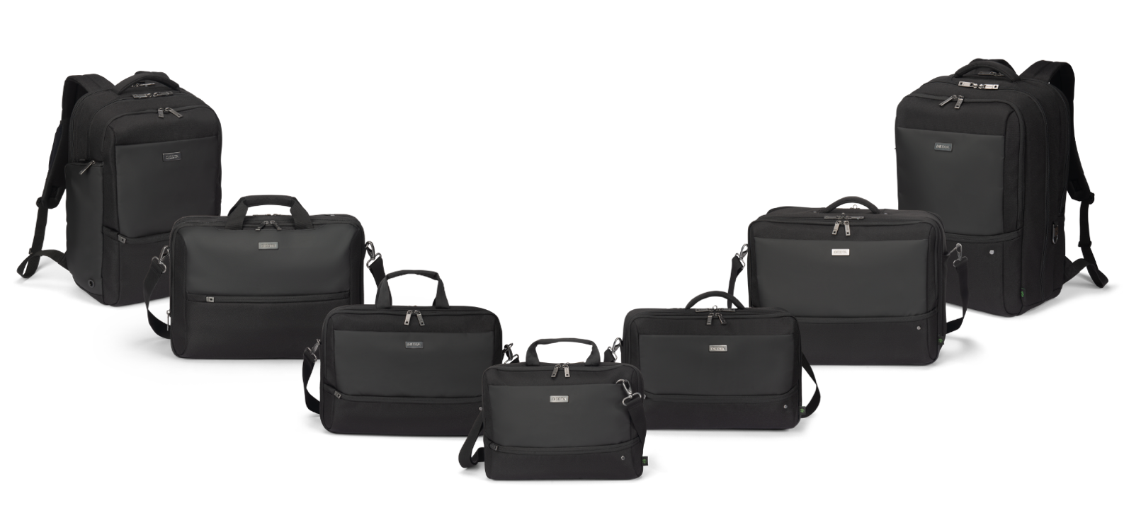
FIVE – PERFORMANCE AND SECURITY
IN EVERY PERSPECTIVE

Slide 6
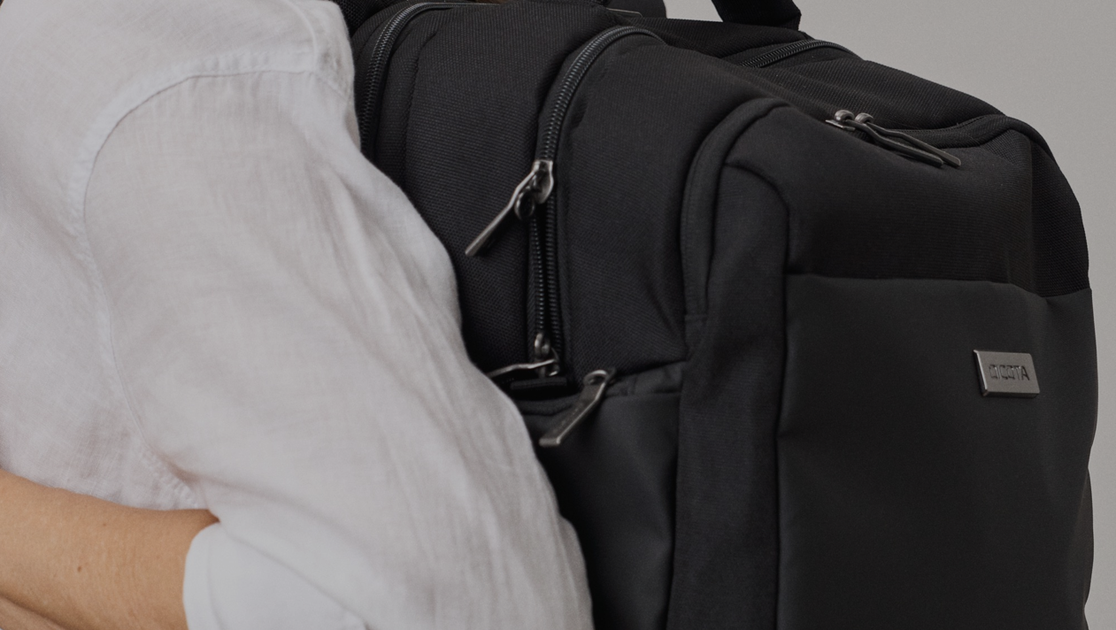
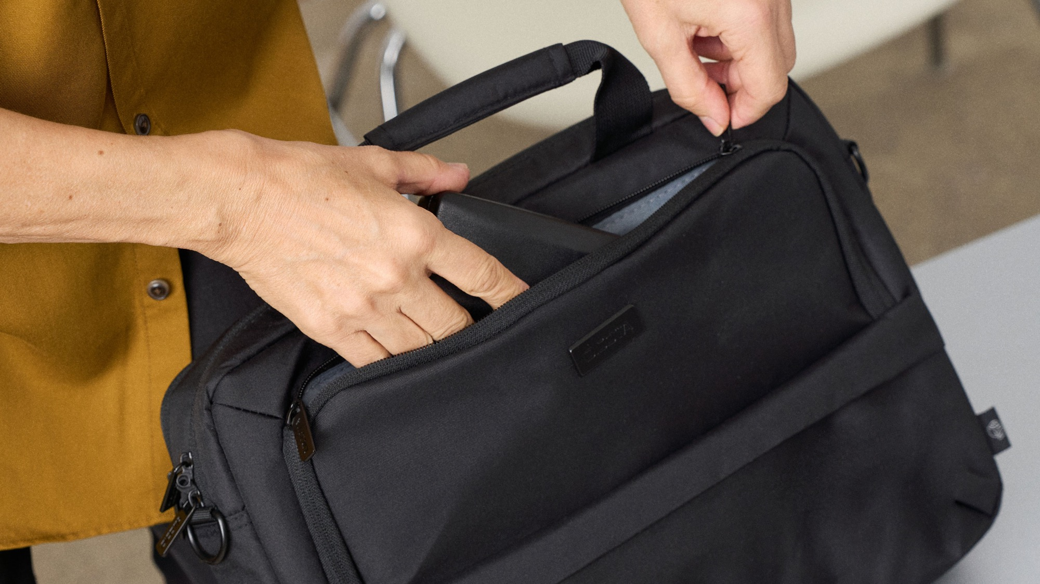
BACKPACK FIVE

Slide 7
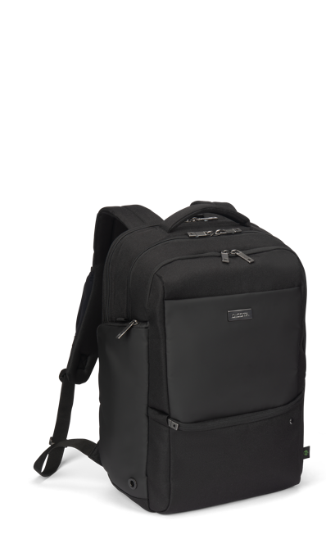
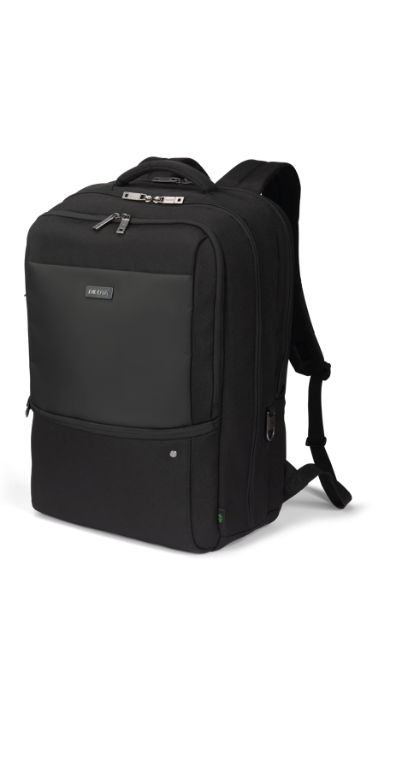
BACKPACK FIVE
Designed for professionals on the go, the Backpack FIVE combines security, organization, and ergonomic comfort in a sleek and functional design. The protective notebook compartment features a V-shaped middle support, ensuring your device stays securely in place and optimally positioned. A front compartment with organized pockets keeps accessories and essentials neatly stored, while the ergonomic, breathable back cushion provides all-day comfort. Made from 32 recycled PET bottles, it’s a sustainable choice that doesn’t compromise on functionality or durability.
  14-16 D32162-RPET
  15-17.3 D32163-RPET

Slide 8
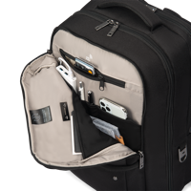
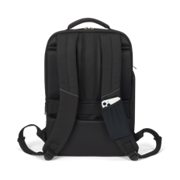
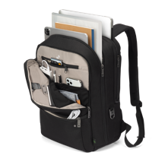
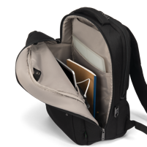
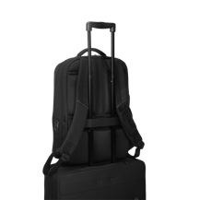
BACKPACK FIVE
DICOTA Cushion Technology (DCT) integrated for a perfect protection
and fit of your notebook device
Main compartment fits tablet, documents, and folders
Mini pocket for quick-access items
Side pocket for umbrella or bottle
Breathable, ergonomic back padding
Trolley belt for easy travel
Metal D-ring for locks or accessories
Lockable zippers with ring lock
Loops for optional waist belt
Hidden tracker slot and RFID-safe pocket
Exchangeable/customizable metal logo plate for branding

Slide 9
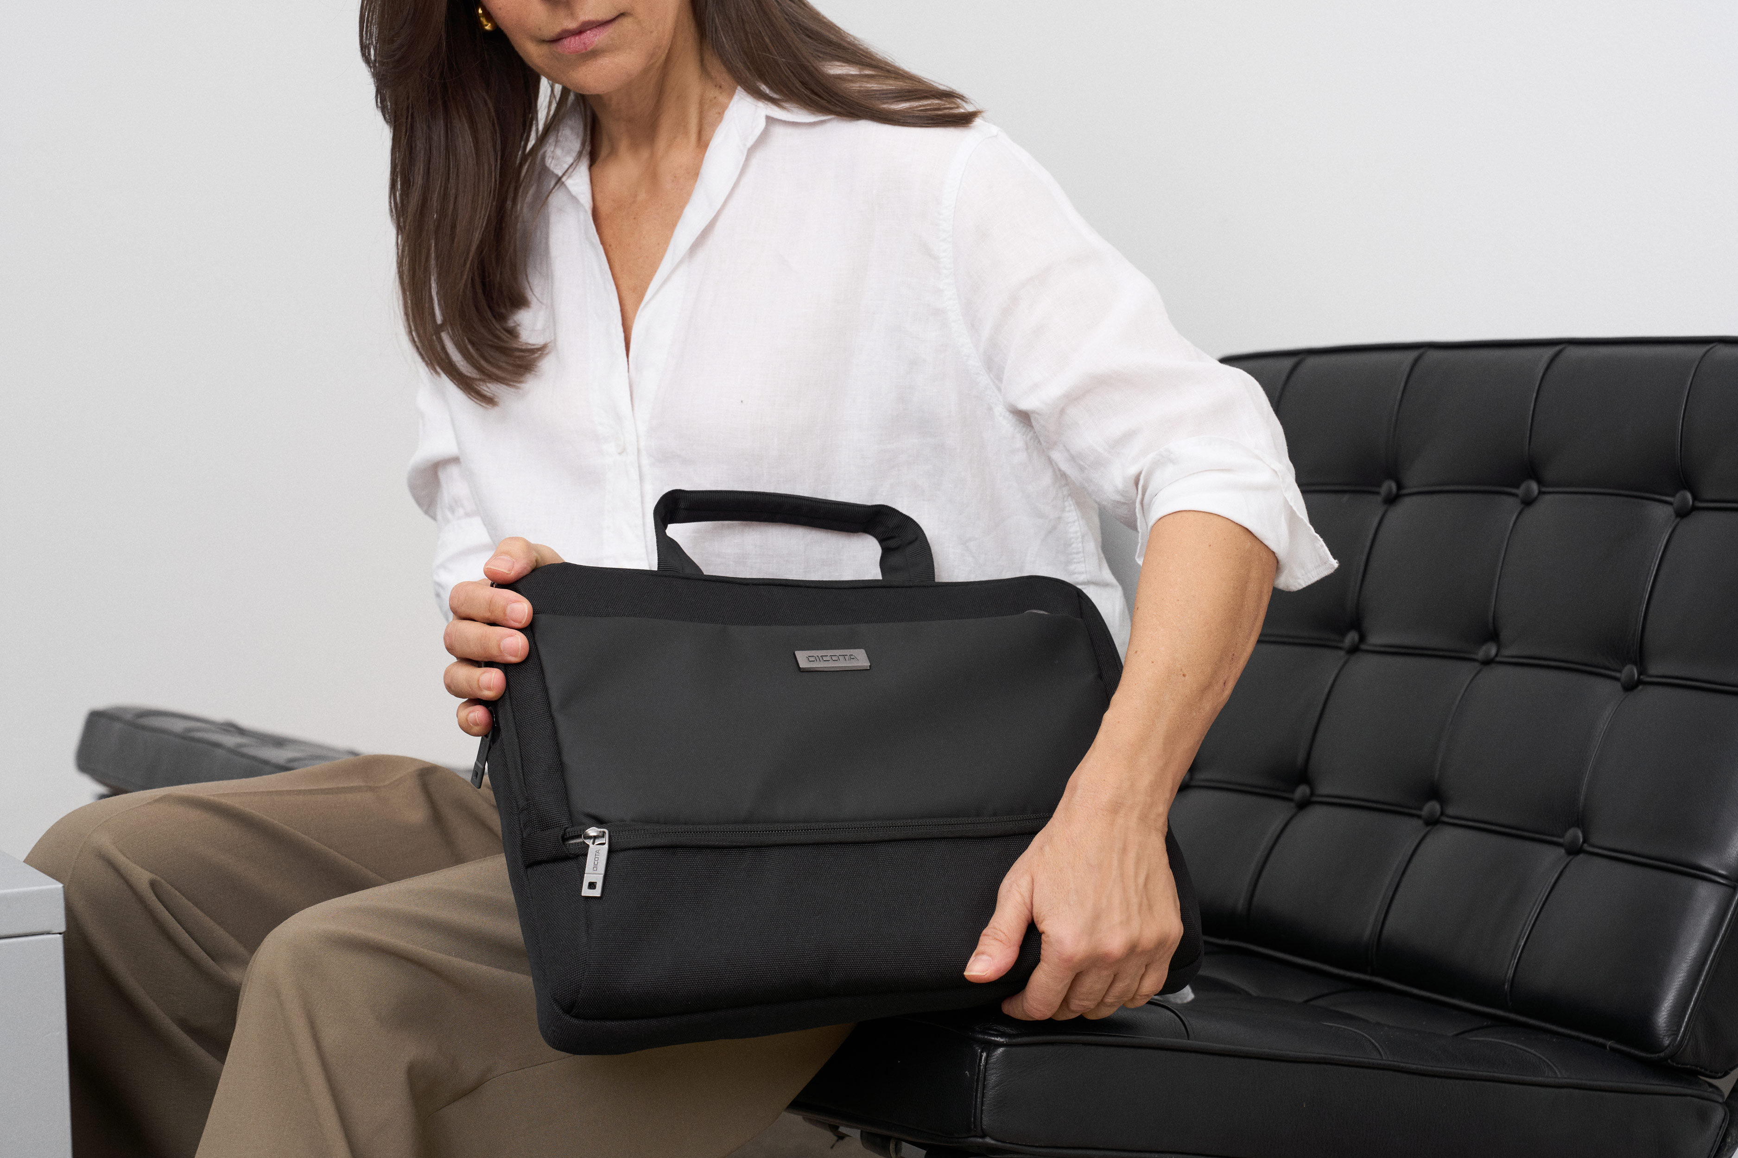
MULTI TWIN FIVE

Slide 10
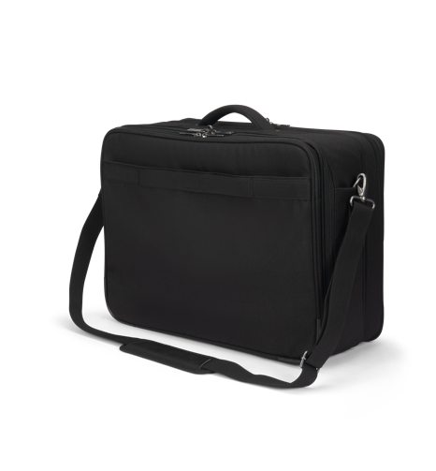
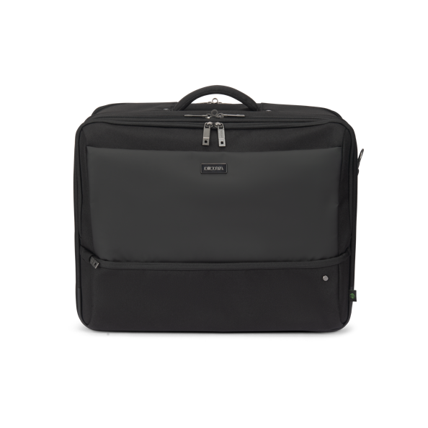
Multi twin FIVE
More than just a bag, the MULTI TWIN FIVE is a secure, functional, and eco-friendly companion for daily business needs. The lockable notebook compartment with HDF foam provides robust protection, while an inner tablet compartment ensures smaller devices are just as safe. A dedicated back compartment keeps documents organized, while the front section offers structured pockets for accessories. Thoughtfully designed for convenience, this bag is also made from 41 recycled PET bottles, combining sustainability with everyday practicality.
  15-17.3 D32164-RPET

Slide 11
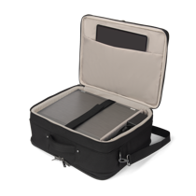
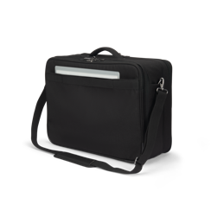
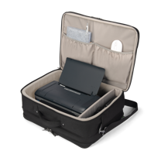
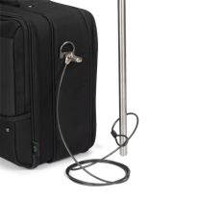
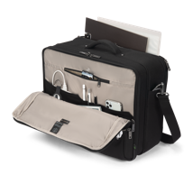
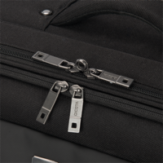
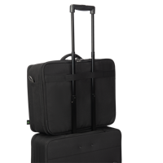
MULTI TWIN FIVE
DICOTA Cushion Technology (DCT) integrated for a perfect protection
and fit of your notebook device
Lockable notebook compartment with HDF padding
Wireframe for additional stability and protection
Padded slot for tablet
Back compartment for documents
Cushioned handle for comfort
Trolley belt for easy transport
Shoulder strap with metal D-ring
Lockable zippers with ring lock
Hidden tracker slot + RFID pocket
Exchangeable/customizable metal logo plate for personal branding

Slide 12
MULTI FIVE

Slide 13
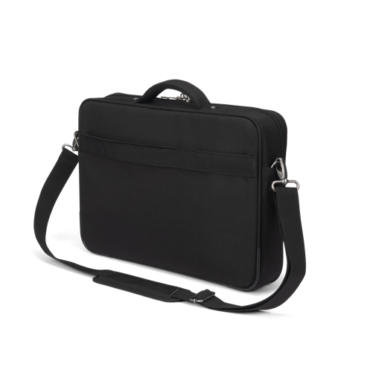
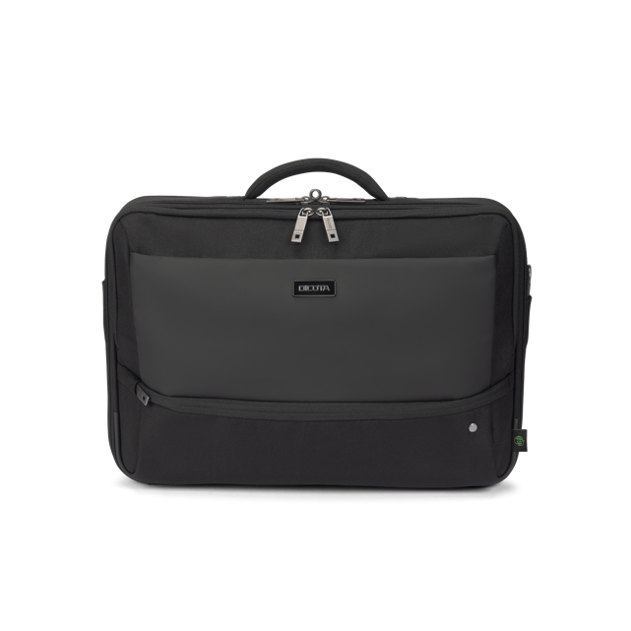
Multi FIVE
A versatile and secure companion for professionals, the MULTI FIVE ensures optimal protection and organization for your devices and documents. The lockable notebook compartment with HDF foam provides maximum safety, while the integrated tablet pocket offers additional storage. A dedicated back compartment keeps documents neatly organized, and the front section features structured pockets for accessories. Made from 19.5 recycled PET bottles, it’s a smart, eco-conscious choice.
  14-16 D32165-RPET

Slide 14
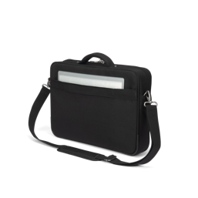
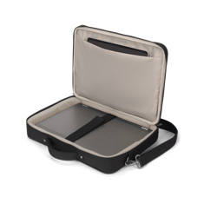
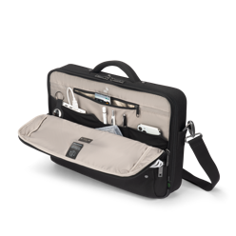
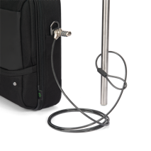
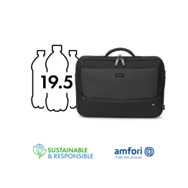
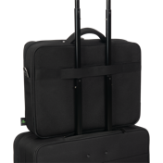
MULTI FIVE
Lockable notebook compartment with HDF padding
Wireframe for additional stability and protection
Tablet slot fits devices up to 12.9”
Trolley belt for smooth travel
Lockable zippers with ring lock for theft protection
Shoulder strap with metal D-ring
Hidden tracker slot + RFID pocket
Cushioned handle for comfort
Exchangeable/customizable metal logo plate for personal branding

Slide 15
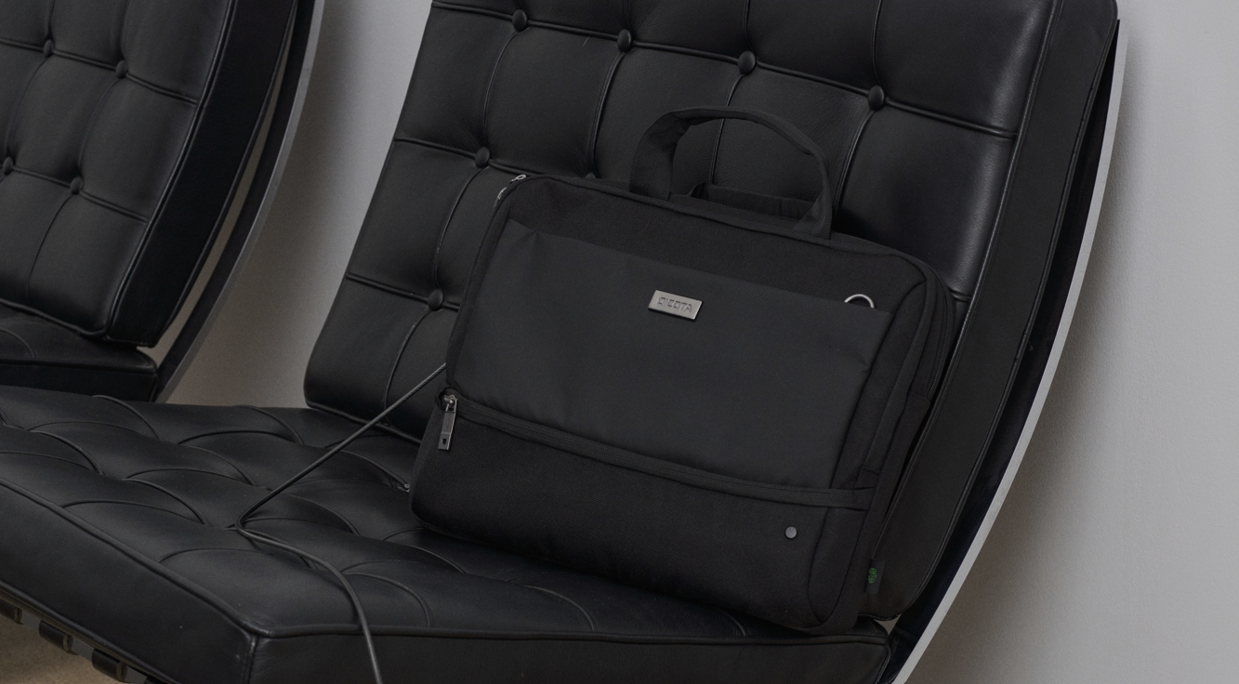
TOP TRAVELLER FIVE

Slide 16
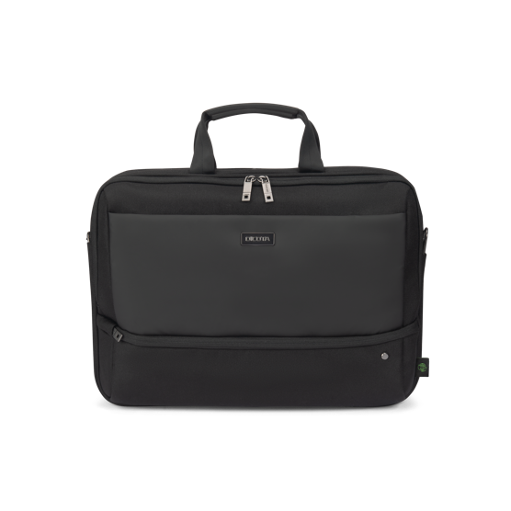
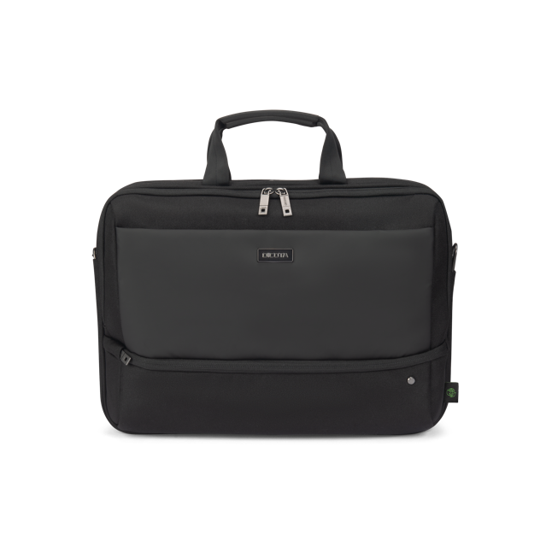
Top traveller FIVE
A secure and organized travel companion, the Top Traveller FIVE is designed to protect your devices while keeping essentials easily accessible. The lockable notebook compartment with DCT Notebook Protection and HDF foam
& EVA corner padding ensures maximum security, while an integrated slip pocket provides safe storage for tablets up to 12.9”. The main compartment offers ample space for documents, folders, or mobile equipment, and the front section features organized pockets for accessories. A small front pocket adds extra storage for cables and smaller items.
Made from 26.5 recycled PET bottles.
  12-14 D32173-RPET
  14-16 D32166-RPET

Slide 17
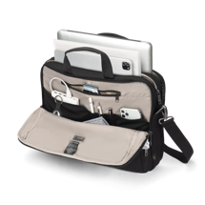
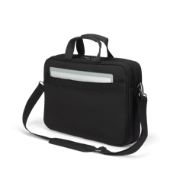
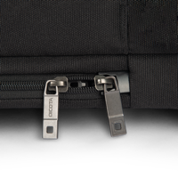
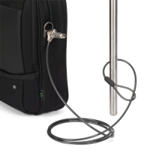
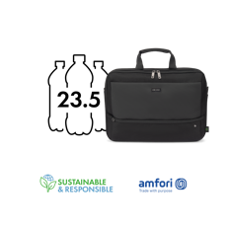
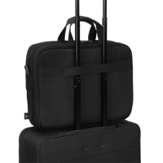
TOP TRAVELLER FIVE
Lockable notebook compartment with HDF & EVA padding
Tablet slot for devices up to 12.9”
Trolley belt for easy transport
Cushioned handle for comfort
Zippers lockable with ring lock for theft prevention
Shoulder strap with metal D-ring
Hidden tracker slot + RFID-safe pocket
Exchangeable/customizable metal logo plate for personal branding

Slide 18
TOP TRAVELLER DUAL FIVE

Slide 19
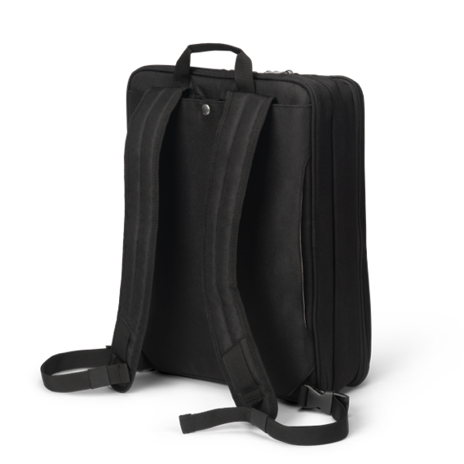
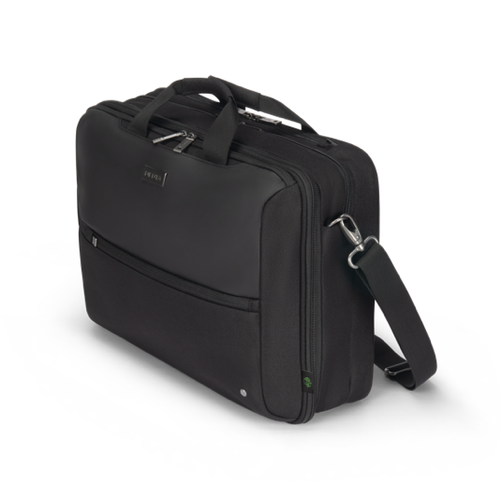
Top traveller dual FIVE
Flexibility meets security with the Top Traveller DUAL FIVE, a convertible business bag that seamlessly transforms from a sleek briefcase into a practical backpack. Equipped with DCT Notebook Protection and a lockable compartment, your laptop stays safe, while the hidden backpack straps allow for effortless switching between carrying styles. The main compartment offers space for tablets, documents, and mobile equipment, while the front section includes structured pockets for accessories and a dedicated small pocket for cables and essentials. Plus, with 35.5 recycled PET bottles used in production, it’s a smart, eco-conscious choice.
  14-16 D32167-RPET

Slide 20
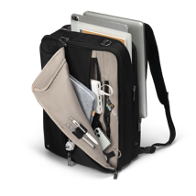
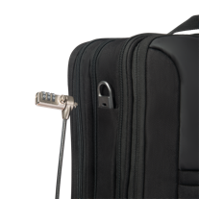



TOP TRAVELLER DUAL FIVE
Converts from Top Traveller to backpack with hidden straps
DCT protection with lockable notebook compartment
Trolley belt for easy transport
Lockable zippers with ring lock
Comfortable carrying handle
RFID pocket + hidden tracker slot
Shoulder strap with metal D-ring
Exchangeable/customizable metal logo plate for personal branding

Slide 21
SLIM CASE FIVE

Slide 22


Slim case five
Lightweight, secure, and designed for effortless mobility, the Slim Case FIVE keeps your essentials protected without the bulk. The lockable notebook compartment with DCT Notebook Protection ensures maximum safety, while an integrated slip pocket securely holds tablets up to 12.9”. A front compartment with structured pockets organizes accessories, and a separate back compartment provides dedicated space for documents. Made from 16.5 recycled PET bottles, it’s a sustainable and practical choice for modern professionals.
  12-14 D32172-RPET

Slide 23






Slim case five
Lockable notebook compartment with DCT Notebook Protection
RFID Blocking Pocket and Hidden Tracker Compartment for enhanced security
Comfortable carrying handle for easy grip
Trolley belt for smooth transport on luggage handles
Lockable zippers with a separate ring lock for extra protection
Additional small front pocket for cables and small items
Detachable shoulder strap with metal D-ring for secure attachment options
Exchangeable/customizable metal logo plate for a personal touch

Slide 24
FIVE: SUMMARY

Slide 25


Slide 26






Find the Perfect Fit for Your Lifestyle
  Six construction types to fit your individual needs
  Fits notebooks up to 17.3“
  Perfect organization on the go
  Fair and sustainably produced
Backpack five
14-16 D32162-RPET
15-17.3 D32163-RPET
Multi five
14-16 D32165-RPET
Multi twin five
15-17.3 D32164-RPET
Top traveller five
12-14 D32173-RPET*
14-16 D32166-RPET
Top traveller dual five
14-16 D32167-RPET*
SLIM CASE five
12-14 D32172-RPET*
*second shipment

Slide 27

FIVE – THE PRICES
SKU No. EAN/GTIN Product Name EUR USD CHF GBP
D32162-RPET 7640239423091 Backpack FIVE 14-16 114.90 129.90 114.90 109.90
D32163-RPET 7640239423107 Backpack FIVE 15-17.3 129.90 129.90 129.90 109.90
D32164-RPET 7640239423114 Multi Twin FIVE 15-17.3 129.90 139.90 129.90 119.90
D32165-RPET 7640239423121 Multi FIVE 14-16 74.90 79.90 74.90 69.90
D32166-RPET 7640239423138 Top Traveller FIVE 14-16 99.90 99.90 99.90 89.90
D32173-RPET* 7640239423237 Top Traveller FIVE 12-14 94.90 99.90 94.90 89.90
D32167-RPET* 7640239423145 Top Traveller DUAL 12-16 119.90 129.90 119.90 109.90
D32172-RPET* 7640239423220 Slim Case FIVE 12-14 79.90 79.90 79.90 69.90
Conditions incl. VAT
Products will be available in Europe from April 2025 (*around June 2025)

Slide 28


SUSTAINIBILITY
Our actions today shape the world of tomorrow. That's why DICOTA favours ecologically sound solutions and manufactures all ECO collections from sustainable recycled PET.
Conservation of resources through high-quality and durable products
All products are 100% free from harmful PVC
Production fully complies with the European REACH standard
Amfori BSCI-certified to improve social performance in global supply chains
Ecovadis committed (Sustainability Report Dec 2024)

Slide 29


You never
work alone.
DICOTA SCHWEIZ AG
Churerstrasse 20, CH-8808 Pfäffikon SZ, Switzerland
www.dicota.com

