Slide 1
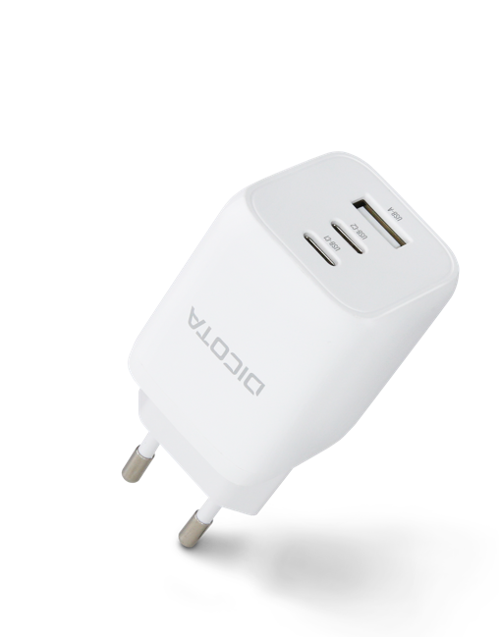


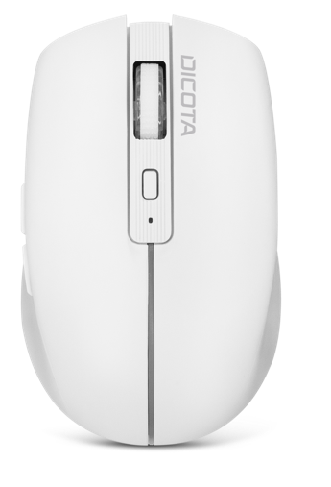
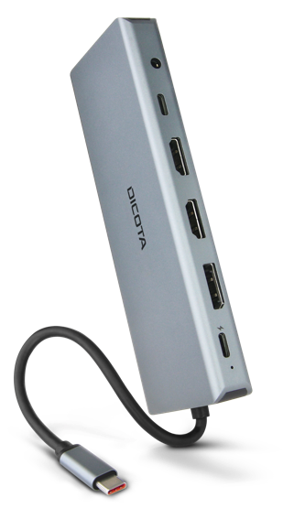
ACCESSORIES
TOPIC
Supporting everyday‘s work – everywhere

Slide 2
CONTENT
CONNECTIVITY
  Adapters • Multifunctional Hubs • Docking Stations
CHARGERS
  Car • Compact • Travel • Desktop
INPUT
  Wired Mice • Wireless Mice • Presenter • Stylus
AUDIO/VIDEO
  Webcams • Webcam Accessories
LOCKS
  Universal • Nano • Wedge • T-Lock • Tools

Slide 3
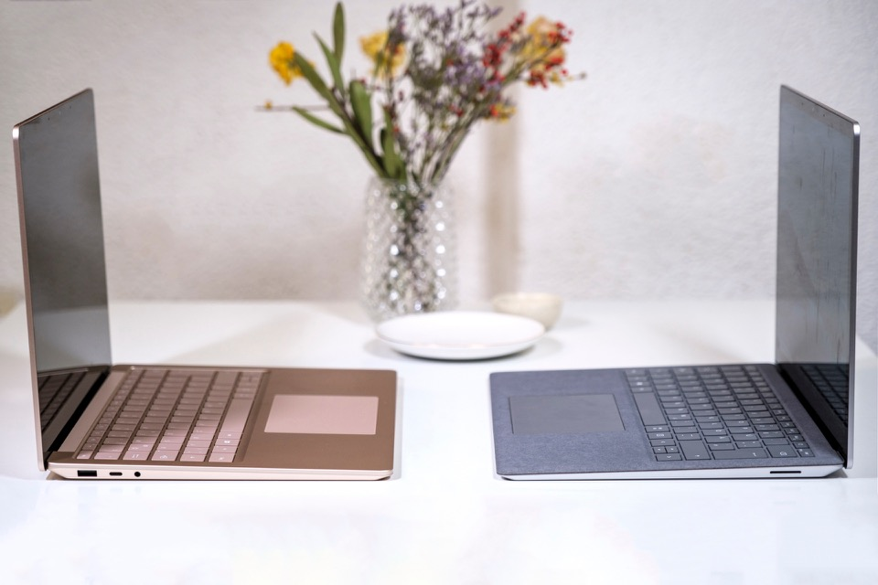
CONNECTIVITY
Mobile computers are more and more what they are expected to be: mobile! That mostly also means less external connectivity is supported. And if we use laptops for work, they are often not moved around but stay on the desk. It is easy to set them up, and they are easy to hide in case space is needed – but they are still lacking options to connect external devices.

Slide 4
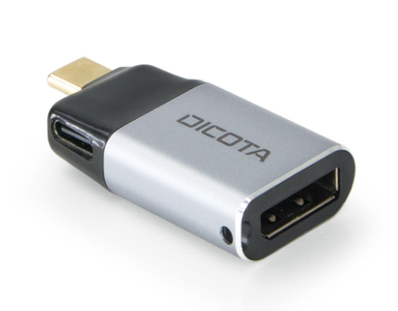
USB-C TO DISPLAYPORT MINI ADAPTER WITH PD (8K/100W)
D32046
  Connects to USB-C port of the notebook
  Supports external displays with up to 8k resolution with up to 60 Hz refresh rate
  1x USB-C power delivery port (100W)
  Compact metal housing, very conventent for travelling and mobile use
  Ideal for connecting the notebook to an external display for presentations or better visibility

Slide 5
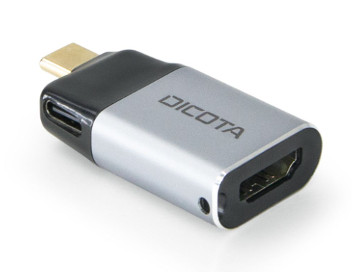
USB-C TO HDMI MINI ADAPTER WITH PD (4K/100W)
D32047
  Connects to USB-C port of the notebook
  Supports external displays with up to 4k resolution with up to 60 Hz refresh rate
  1x USB-C power delivery port (100W)
  Compact metal housing, very conventent for travelling and mobile use
  Ideal for connecting the notebook to an external display for presentations or better visibility

Slide 6
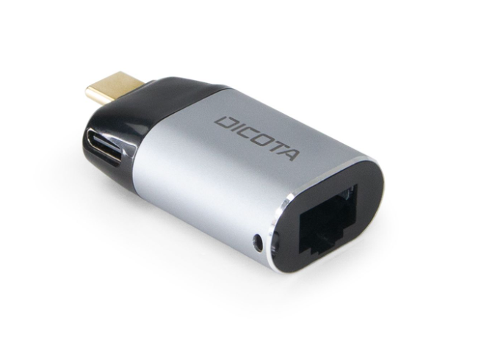
USB-C TO ETHERNET MINI ADAPTER WITH PD (100W)
D32048
  Connects to USB-C port of the notebook
  Supports connection to a wired network with up to 1000 Mbps speed
  1x USB-C power delivery port (100W)
  Compact metal housing, very conventent for travelling and mobile use
  Ideal for connecting the notebook to an wired network for highere data transfer rates and more stability than wireless connections

Slide 7
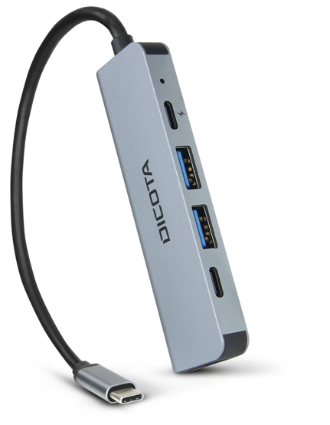
USB-C 5-IN-1 VIDEO HUB 4K PD 100W
D32060
  Connects to USB-C port of the notebook
  1x HDMI video port with up to 4k resolution
  2x USB-A, 2x USB-C ports
  Power Delivery up to 100 W
  Aluminium housing for optimised heat transfer
  Compact companion for travelling and occasional use with external monitor

Slide 8
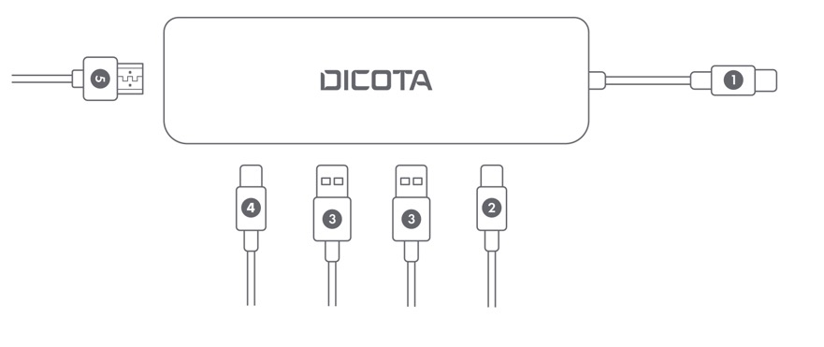
USB-C 5-IN-1 VIDEO HUB 4K PD 100W
D32060
  USB-C connection to notebook
  USB-C with Power Delivery up to 100 W
  USB-A 3.0 port
  USB-C3.0 port
  HDMI connection up to 4k/30 Hz

Slide 9
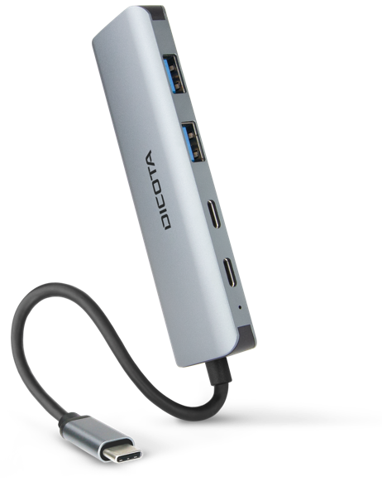
USB-C 4-IN-1 HIGHSPEED HUB 10 GBPS
D32061
  Connects to USB-C port of the notebook
  2x USB-C 3.2, 2x USB-A 3.2 ports with high data transfer rates of up to 10 Gbps
  Aluminium housing for optimized heat transfer
  Perfect enhancement of the internal USB ports of the notebook
  Convenient use of external devices with high data transfer rates (e.g. hard discs)

Slide 10
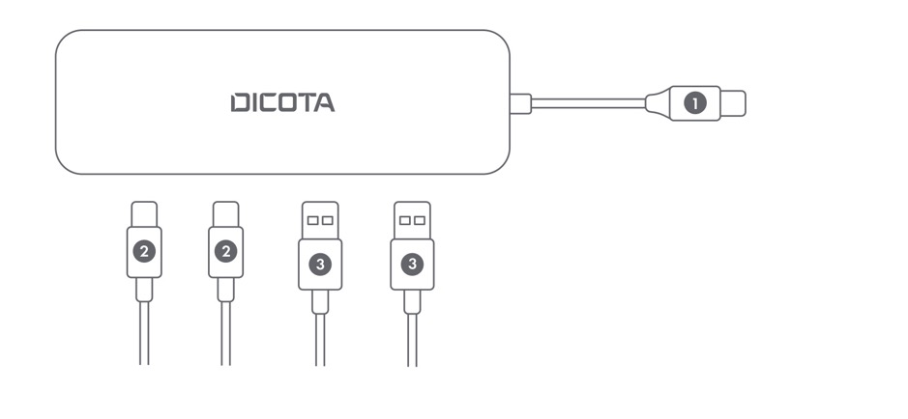
USB-C 4-IN-1 HIGHSPEED HUB 10 GBPS
D32061
  USB-C connection to notebook
  USB-C 3.2 port 10 Gbps
  USB-A 3.2 port 10 Gbps

Slide 11
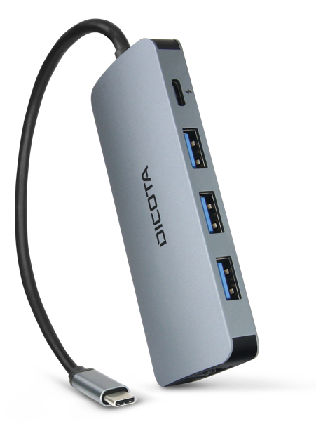
USB-C 8-IN-1 MULTI HUB 4K PD 100W
D32062
  Connects to USB-C port of the notebook
  1x HDMI video port with up to 4k resolution
  3x USB-A, 1x USB-C ports
  Ethernet port up to 100 Mbps
  SD/microSD card slot
  Power Delivery up to 100 W
  Aluminium housing for optimised heat transfer
  Compact companion for travelling and occasional use with external monitor

Slide 12
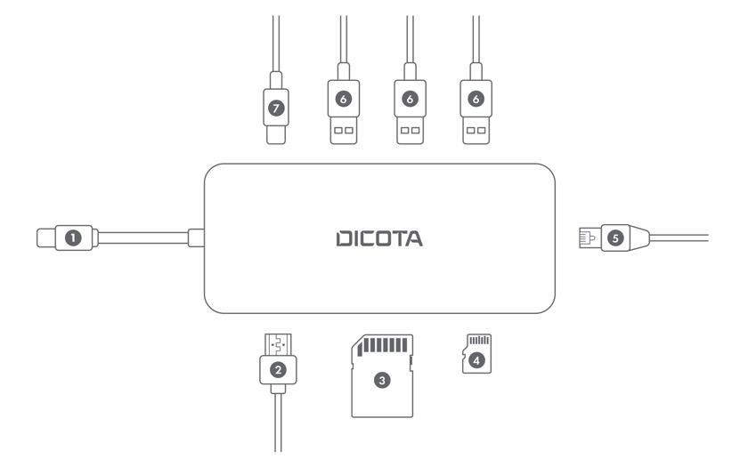
USB-C 8-IN-1 MULTI HUB 4K PD 100W
D32062
  USB-C connection to notebook
  1x HDMI video port with up to 4k resolution
  SD card slot
  MicroSD card slot
  Ethernet GLAN RJ45 port with 10/100/1000 Mbps
  USB-A 3.0 port
  USB-C with Power Delivery up to 100 W

Slide 13
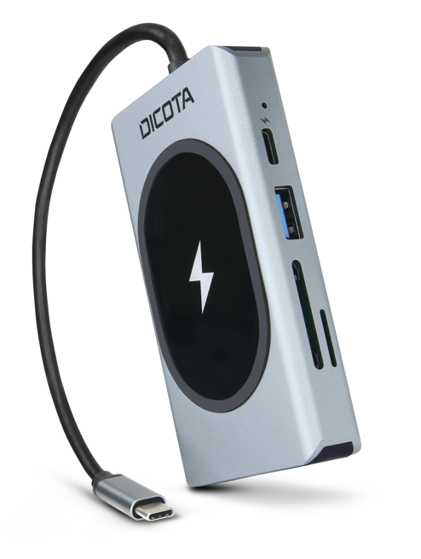
USB-C 10-IN-1 CHARGING HUB 4K PD 100W
D32059
  Connects to USB-C port of the notebook
  1x HDMI video port with up to 4k resolution, 1x VGA video port with up to 1080p resolution
  1x USB-A, 2x USB-C ports, 1x 3.5 mm audio/microphone combo socket
  Ethernet port up to 100 Mbps, SD/microSD card slot
  Wireless charging up to 15 W, Power Delivery up to 100 W
  Aluminium housing for optimised heat transfer
  Universal connectivity tool incl. Convenient wireless charging option for smartphones

Slide 14
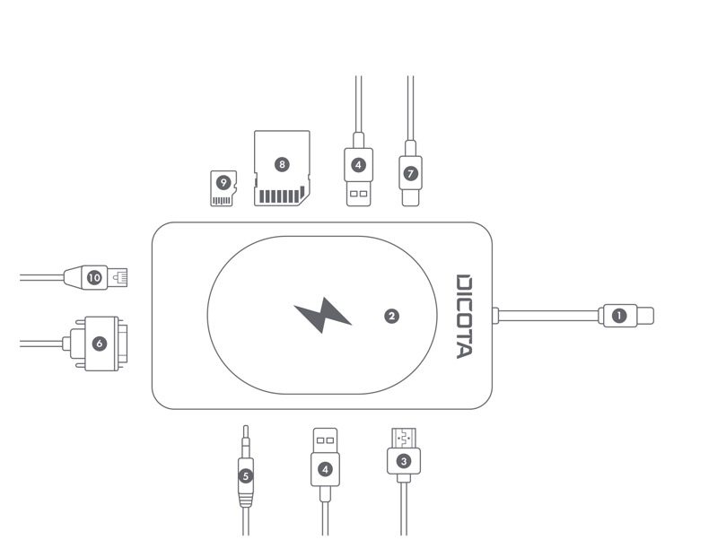
USB-C 10-IN-1 CHARGING HUB 4K PD 100W
D32059
  ÚSB-C connection to notebook
  Wireless charging module 15 W
  HDMI port up to 4k/30 Hz
  USB-A 3.0 port
  3,5 mm audio/microphone combo socket
  VGA port up to 1080p/60 Hz
  USB-C port with Power Delivery up to 100 W
  SD card slot
  9. MicroSD card slot
  10. Ethernet GLAN RJ45 port with 10/100/1000 Mbps

Slide 15
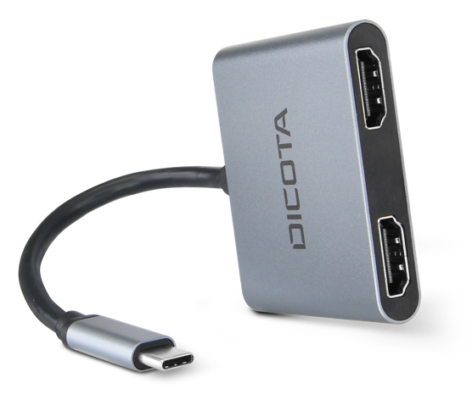
USB-C PORTABLE 4-IN-1 MINI DOCKING STATION 4K HDMI PD 100W
D32063
  Connects to USB-C port of the notebook
  2x HDMI video port with up to 4k resolution,
  1x USB-A, 1x USB-C ports
  Power Delivery up to 100 W
  Aluminium housing for optimised heat transfer
  Compact and portable docking station with up to 2 multiple displays for desktop mirroring or enhancement

Slide 16
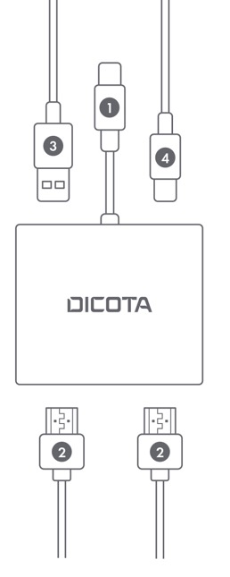
USB-C PORTABLE 4-IN-1 MINI DOCKING STATION 4K HDMI PD 100W
D32063
  USB-C connection to notebook
  HDMI port up to 4k/30 Hz
  USB-A 3.0 port
  USB-C port with Power Delivery up to 100 W

Slide 17
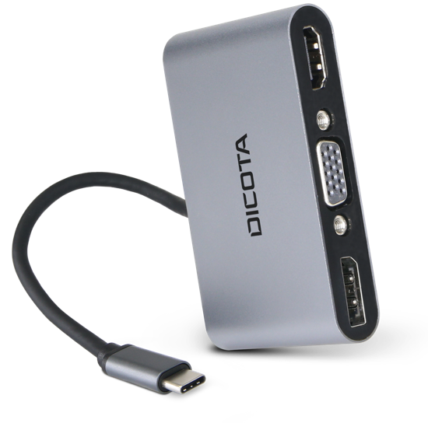
USB-C PORTABLE 5-IN-1 MINI DOCKING STATION 4K HDMI DP PD 100W
D32064
  Connects to USB-C port of the notebook
  1x DisplayPort video port with up to 4k resolution
  1x HDMI video port with up to 4k resolution,
  1x VGA video port with up to 1080p resolution
  1x USB-A, 1x USB-C ports
  Power Delivery up to 100 W
  Aluminium housing for optimised heat transfer
  Compact and portable docking station with up to 2 multiple displays for desktop mirroring or enhancement

Slide 18
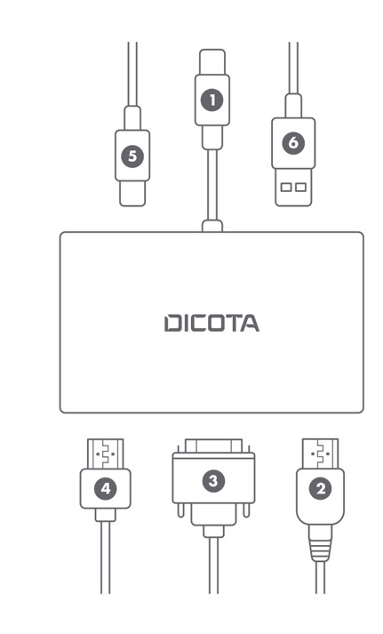
USB-C PORTABLE 5-IN-1 MINI DOCKING STATION 4K HDMI DP PD 100W
D32064
  USB-C connection to notebook
  DisplayPort video port up to 4k/ 30 Hz
  VGA port up to 1080p/60 Hz
  HDMI port up to 4k/ 30 Hz
  USB-C port with Power Delivery up to 100 W
  USB-A 3.0 port

Slide 19

USB-C 13-IN-1 DOCKING STATION 4K HDMI/DP PD 100W
D32065
  Connects to USB-C port of the notebook
  1x DisplayPort video port with up to 4k resolution
  2x HDMI video port with up to 4k resolution,
  4x USB-A, 2x USB-C ports, Power Delivery up to 100 W
  Ethernet port up to 1000 Mbps, SD/microSD card slot
  1x 3,5mm audio/microphone combo socket
  Aluminium housing for optimised heat transfer
  Compact and portable docking station with up to 2 multiple displays for desktop mirroring or enhancement

Slide 20
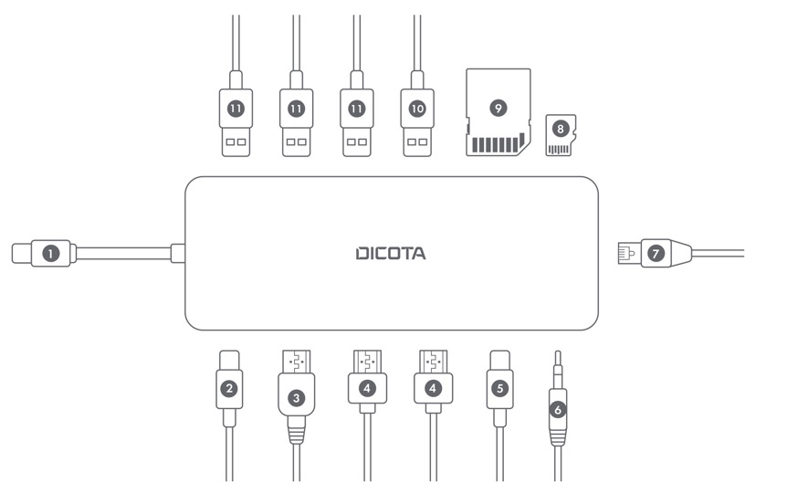
USB-C 13-IN-1 DOCKING STATION 4K HDMI/DP PD 100W
D32065
  USB-C connection to notebook
  USB-C port with Power Delivery up to 100 W
  Display Port video port up to 4k/60 Hz
  HDMI port up to 4k/60 Hz
  USB-C 2.0 port
  3,5 mm audio/microphone combo socket
  Ethernet port up to 1000 Mbps
  SD card slot
  MicroSD card slot
  10. USB-A 2.0 port
  11. USB-A 3.0 port

Slide 21

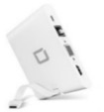




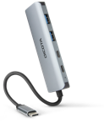


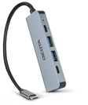



OVERVIEW
150€
SRP
D32065
D31729
95€
80€
D32059
65€
D32064
D32062
D31730
50€
D32048
D32061
D31731
D32063
35€
NEW
EXISTING
D32060
30€
D32047
D32046
Adapter
Multifunctional Hubs
Docking Stations I

Slide 22





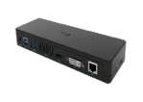
OVERVIEW
290€
SRP
D32006
D31951
260€
230€
D31952
D31953
200€
180€
160€
D31949
PROJECT ONLY
140€
D31950
Docking Stations II

Slide 23
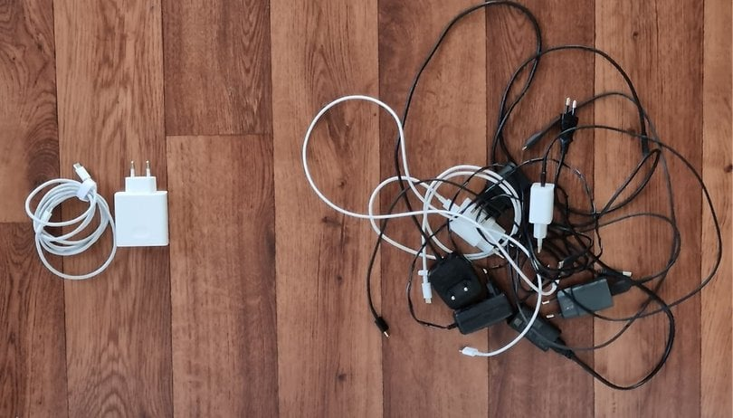
CHARGERS
Working with mobile devices requires to charge them every now and then. Thanks to latest regulations, many devices are using USB connections for charging.

Slide 24
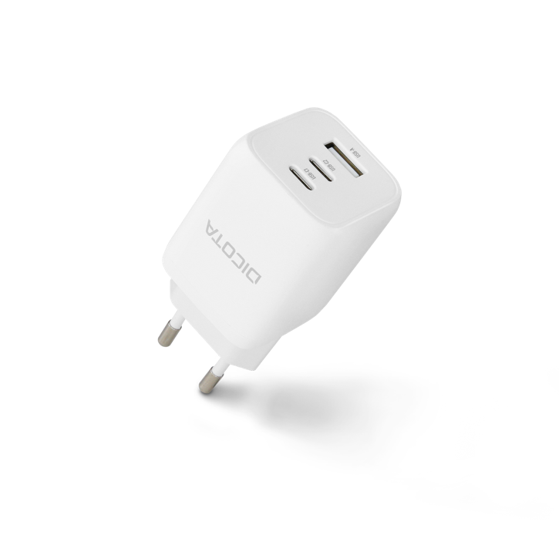
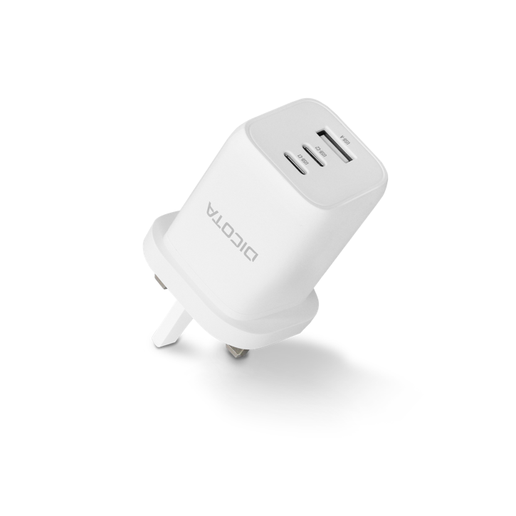
COMPACT LAPTOP GAN CHARGER (65W)
D32054/D32055
  2x USB-C port with Power Delivery, 1x USB-A port
  Universal for tablets, smartphones or laptops
  EU- and UK-version available
  Protected against over-yoltage, over-current, short circuit and overheating
  Chargers with newest Gallium-Nitrit technology for compact size and efficient charging

Slide 25
COMPACT 3-PORT GAN CHARGER (65W)
D32054/D32055
  Maximum power: 65 W
  Input AC 100-240 V 50/60 Hz 2.5 A
  Single Port: USB-C1/2: 5V/3A, 9V/3A, 12V/3A, 15V/3A, 20V/3.25A (60W max)
  USB-A: 4.5V/5A, 5V/4.5A, 9V/3A, 12V/2.5A, 20V/1.5A (30W max)
  Double Port: USB-C1+USB-C2: 45W (5V/9V/12V/15V/3A, 20V/2.25A) + 20W (5V/3A, 9V/2.2A, 12V/1.67A)
  USB-C1+USB-A: 5W (5V/9V/12V/15V/3A, 20V/2.25A) + 18W (5V/3A, 9V/2A, 12V/1.5A)
  USB-C2+USB-A: 5V/3A (share)
  Triple Port: USB-C1+C2+A: 45W (5V/9V/12V/15V/3A, 20V/2.25A) + 5V/3A (shared C2/A)

Slide 26
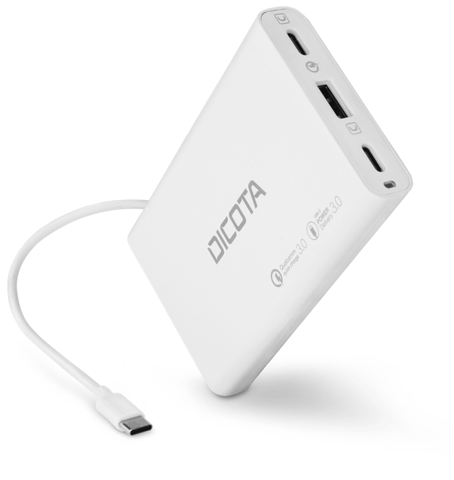
3-PORT DESKTOP CHARGER UNIVERSAL (65W)
D32056
  2x USB-C port with Power Delivery, 1x USB-A port
  Universal for tablets, smartphones or laptops
  EU- and UK-power cable plus USB-C connection cable included
  Protected against over-voltage, over-current, short circuit and overheating
  Convenient charging device for the desktop

Slide 27
3-PORT DESKTOP CHARGER UNIVERSAL (65W)
D32056
  Maximum power 65W
  Input: AC 100-240V 50/60Hz 2.5A
  Output: USB-C: 5,9,12,15,20V/3.25ª
            USB-A: 5V/3A,9V/3A,12V/3A,20V/3A
:

Slide 28
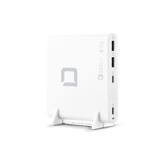
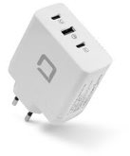
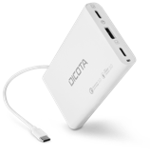
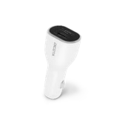
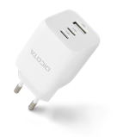
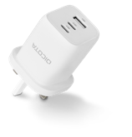
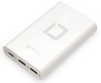

OVERVIEW
SRP
125€
D31893
100€
D31983
D32056
75€
D31932
D32054
D32055
D31720
50€
NEW
EXISTING
D31984
25€
Car Charger
Compact Charger
Travel Charger
Desktop Charger

Slide 29

INPUT
Convenient input devices, be it for working at a desk or presenting content in a meeting, are key to efficient work. And having wireless devices equipped with rechargeable batteries helps saving the environment from battery waste.

Slide 30

WIRELESS MOUSE BT/2.4G NOTEBOOK
D32044
  Connection either directly with Bluetooth or with the included 2.4GHz USB receiver
  Rechargeable battery with USB-C charging port, on/off switch for transportation
  Adjustable sensor sensitivity (800/1200/1600 dpi)
  2 additional side buttons for easy navigation
  Plug and play – no software installation needed

Slide 31
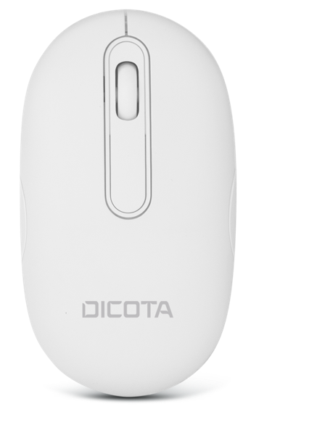
WIRELESS MOUSE BT/2.4G DESKTOP
D32045
Connection either directly with Bluetooth or with the included 2.4GHz USB receiver
Rechargeable battery with USB-C charging port, on/off switch for transportation
Adjustable sensor sensitivity (800/1200/1600 dpi)
Symmetrical design makes it perfect for both right and left hand use
Plug and play – no software installation needed

Slide 32
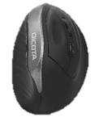






OVERVIEW
SRP
30€
D31981
D32045
D32044
20€
15€
D31980
D32003
10€
NEW
EXISTING
D31659
7€
D32011
Wired USB
Wireless 2.4 GHz
Wireless Bluetooth
Wireless Combo

Slide 33
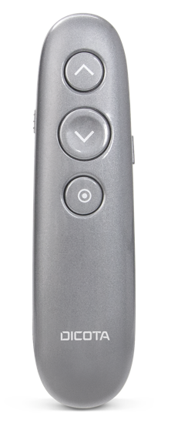
WIRELESS VIRTUAL PRESENTER
D32058
Connection with the included 2.4GHz USB receiver
Rechargeable battery with USB-C charging port, on/off switch for transportation
Digital/virtual „laser pointer“ allows presentations on any projection surface (software installation needed)
Timer function with vibration alarm

Slide 34


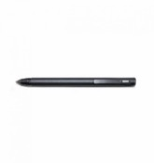
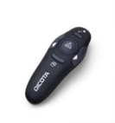
OVERVIEW
SRP
70€
D31937
60€
D32058
D31260
50€
40€
NEW
EXISTING
30€
D30933-V1
Tablet Stylus
Presenter

Slide 35
AUDIO/VIDEO
  Working remotely also means staying in contact with workmates. The modern tools such as Skype or Teams easily integrate video calls which demand the right A/V equipment.

Slide 36
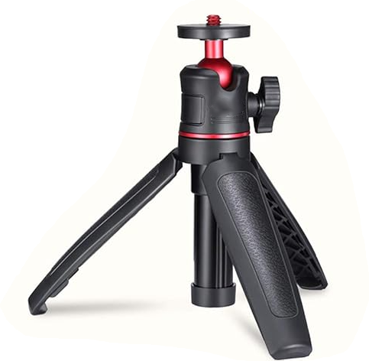
WEBCAM TRIPOD
D32049
Universal stand for webcams
Height adjustable (147mm – 245mm)
Tilt & swivel top for optimal positioning
Compact and ideal for mobile use

Slide 37






OVERVIEW
SRP
180€
D31892
120€
90€
D31888
60€
D31841
30€
NEW
EXISTING
D31944
20€
D32049
D31780
Webcams
Webcam Accessories

Slide 38

LOCKS
  Certain environments demand to keep your notebook, your monitor, or other external devices safe from being taken away. Security Locks are helping to prevent the quick theft of these devices.

Slide 39


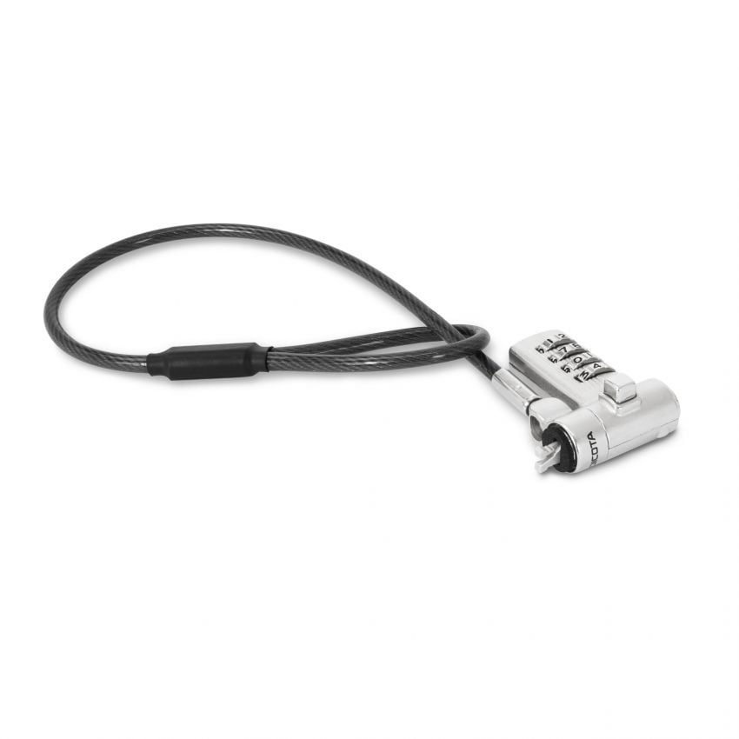
LOCK UNIVERSAL MINI
D32050/D32068
  D32050: 4-digit resettable combination lock
  D32068: keyed lock
  3 exchangeable lock heads for universal use
  300x4.4mm steel cable
  Perfect to be added to an existing lock and to secure additional devices, e.g. displays or printers

Slide 40
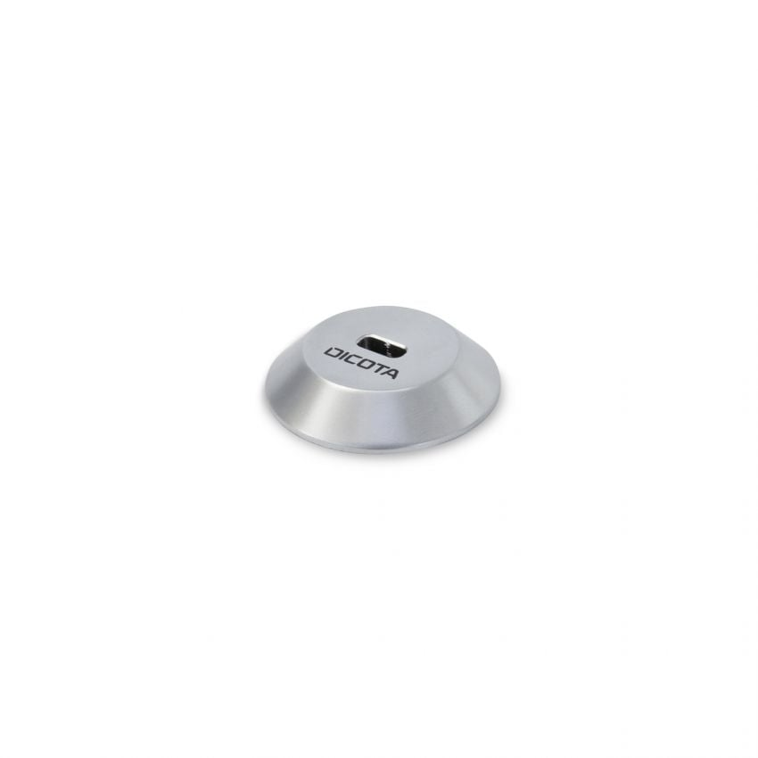
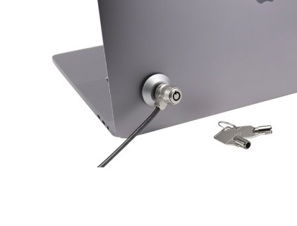
LOCK ANCHOR PLATE FOR T-LOCK
D32052
Adds the option for a security lock to devices without a slot
Self-adhesive 3M-tape included, sticks to all flat and smooth surfaces
High pull resistance (up to 60kg force)

Slide 41
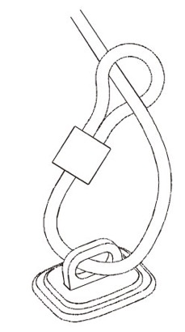


LOCK BASE PLATE
D32053
Creates a fixed locking point for security locks
Self-adhesive 3M-tape included, sticks to all flat and smooth surfaces
Can also be fixed with screws (included) for additional resistance
High pull resistance (up to 75kg force)

Slide 42
AT YOUR SERVICE
THANK YOU FOR YOUR ATTENTION
DICOTA SWITZERLAND AG
Churerstrasse 20
CH-8808 Pfäffikon SZ
Phone +41 55 416 50 30
Fax +41 55 416 50 39
www.dicota.com

